Slide 1
UNIT – III DESIGN AND ANALYSIS OF ALGORITHMS

Slide 2
GREEDY METHOD

Slide 3
BASIC METHOD
The Greedy method is most straight forward design technique
It can be applied to a wide variety of problems, most of these problems have n-inputs and require us to obtain a subset that satisfies some constraints.
Any subset that satisfies these constraints is called feasible solution.
We need to find a feasible solution that either maximizes or minimizes a given objective function.
A feasible solution that does this is called Optimal solution
Greedy method works in stages, consider one input at a time.
At each stage, a decision is made regarding whether a particular input is in an optimal solution.
This is done by considering inputs in an order by some selection procedure.

Slide 4
BASIC METHOD
A greedy algorithm has five components:
A set of candidates, from which to create solutions.
A selection function, to select the best candidate to add to the solution.
A feasible function is used to decide if a candidate can be used to build a solution.
An objective function, fixing the value of a solution or an incomplete solution.
An evaluation function, indicating when you find a complete solution.

Slide 5
BASIC METHOD
Algorithm Greedy( a, n)
{
solution = φ;
for i := 1 to n do
{
x := Select(a);
if Feasible(solution, x);
solution := union(solution, x);
}
return solution;
}

Slide 6
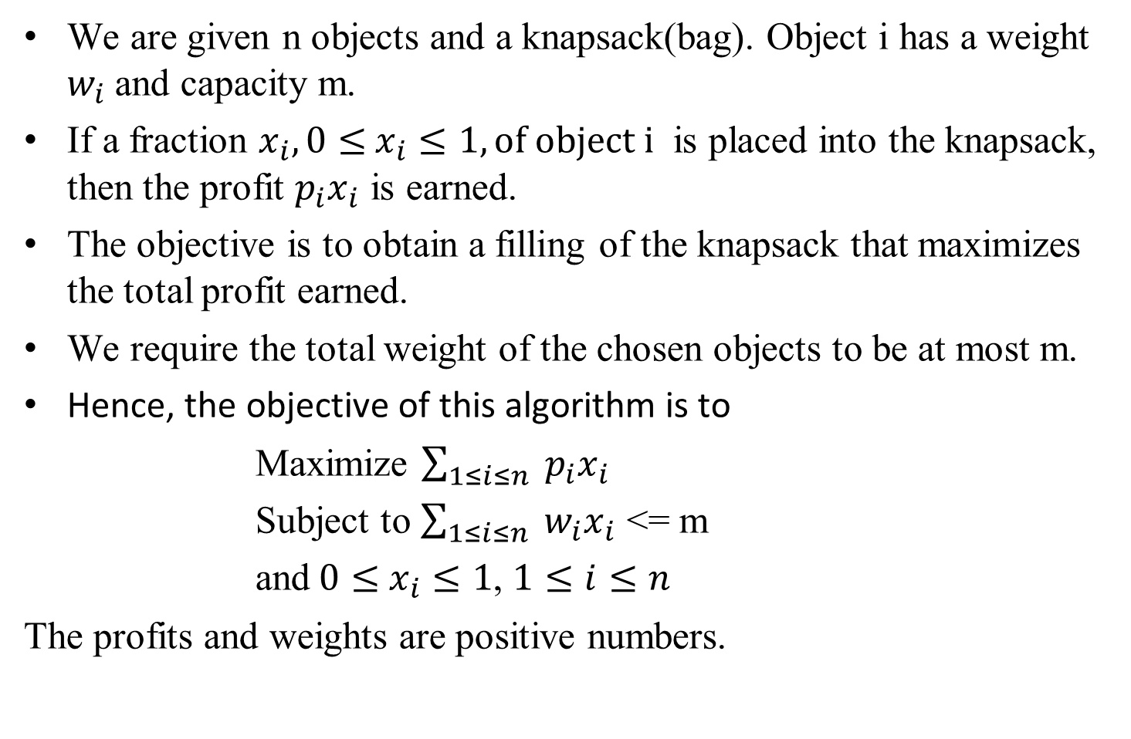
KNAPSACK PROBLEM
We are given n objects and a knapsack(bag). Object i has a weight $w_{i}$and capacity m.
If a fraction $x_{i}, 0≤x_{i}≤1, of object i$ is placed into the knapsack, then the profit $p_{i}x_{i}$ is earned.
The objective is to obtain a filling of the knapsack that maximizes the total profit earned.
We require the total weight of the chosen objects to be at most m.
Hence, the objective of this algorithm is to
Maximize $\sum_{1≤i≤n}{{ p}_{i}x_{i}}$
Subject to $\sum_{1≤i≤n}{{ w}_{i}x_{i}}$<= m
and$0≤x_{i}≤1$, $1≤i≤n$
The profits and weights are positive numbers.

Slide 7
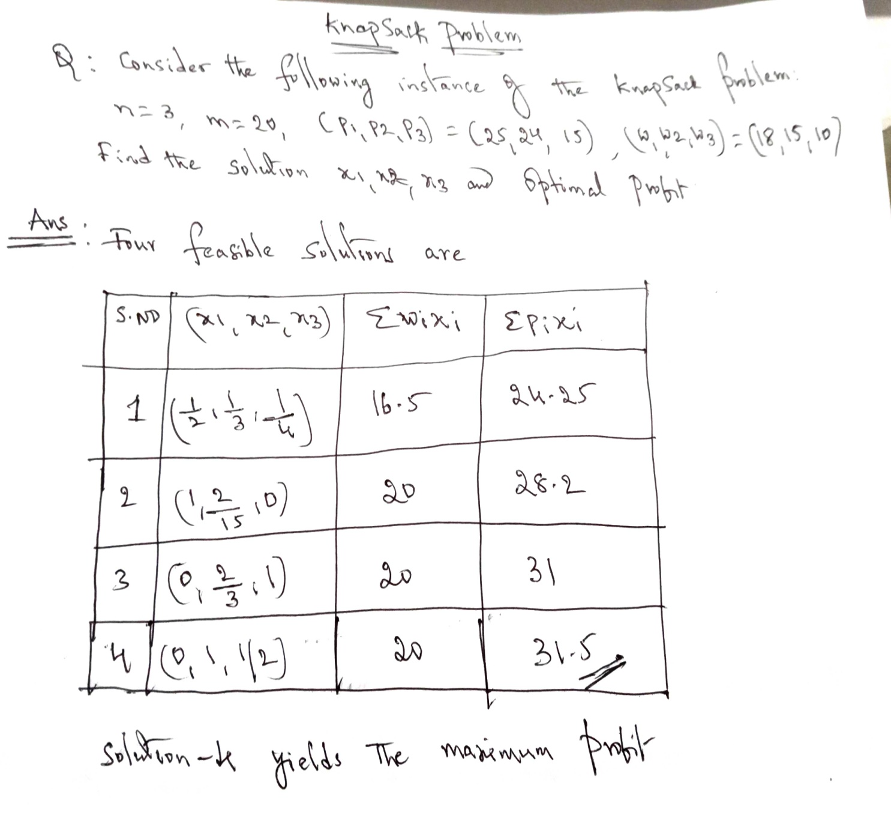
KnapSack Problem

Slide 8
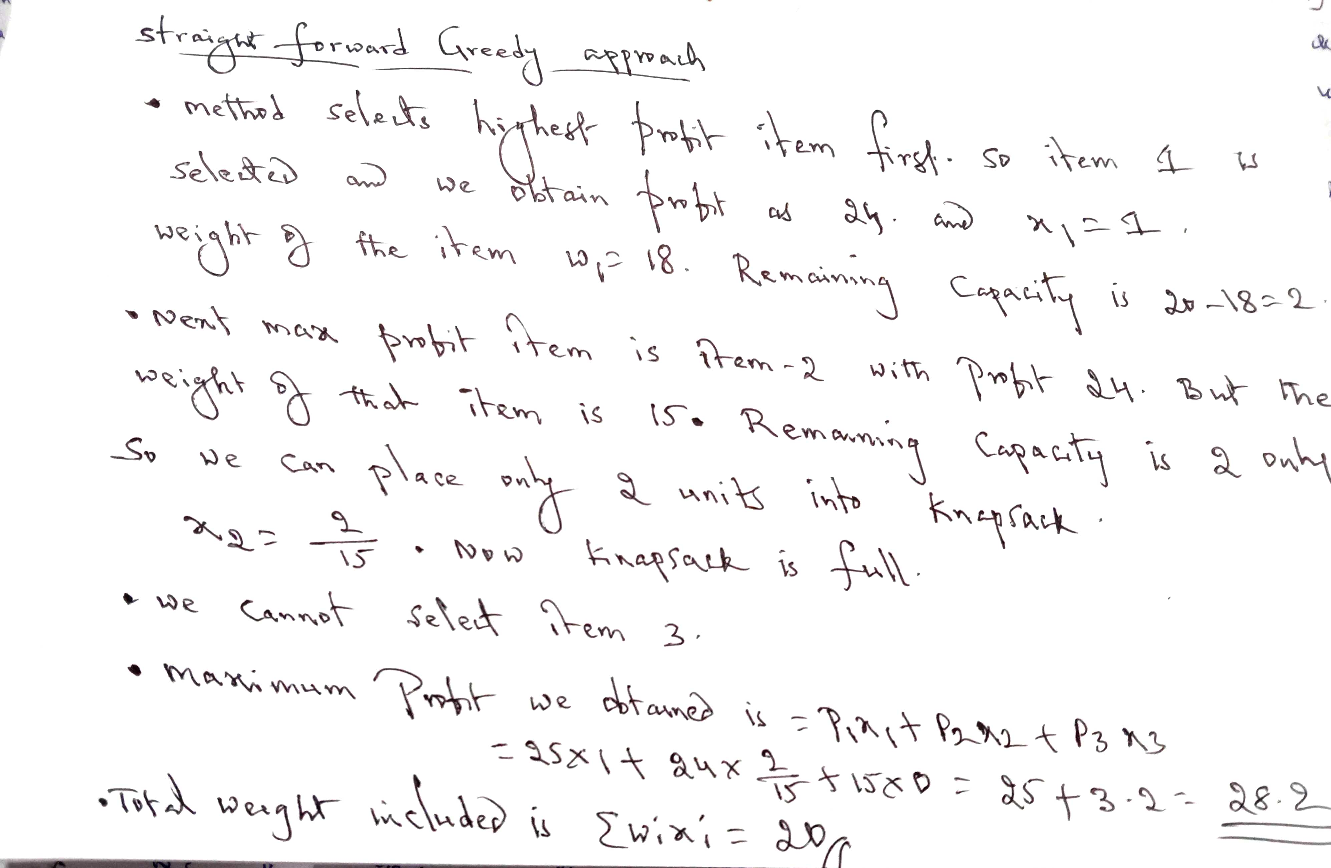
KnapSack Problem

Slide 9
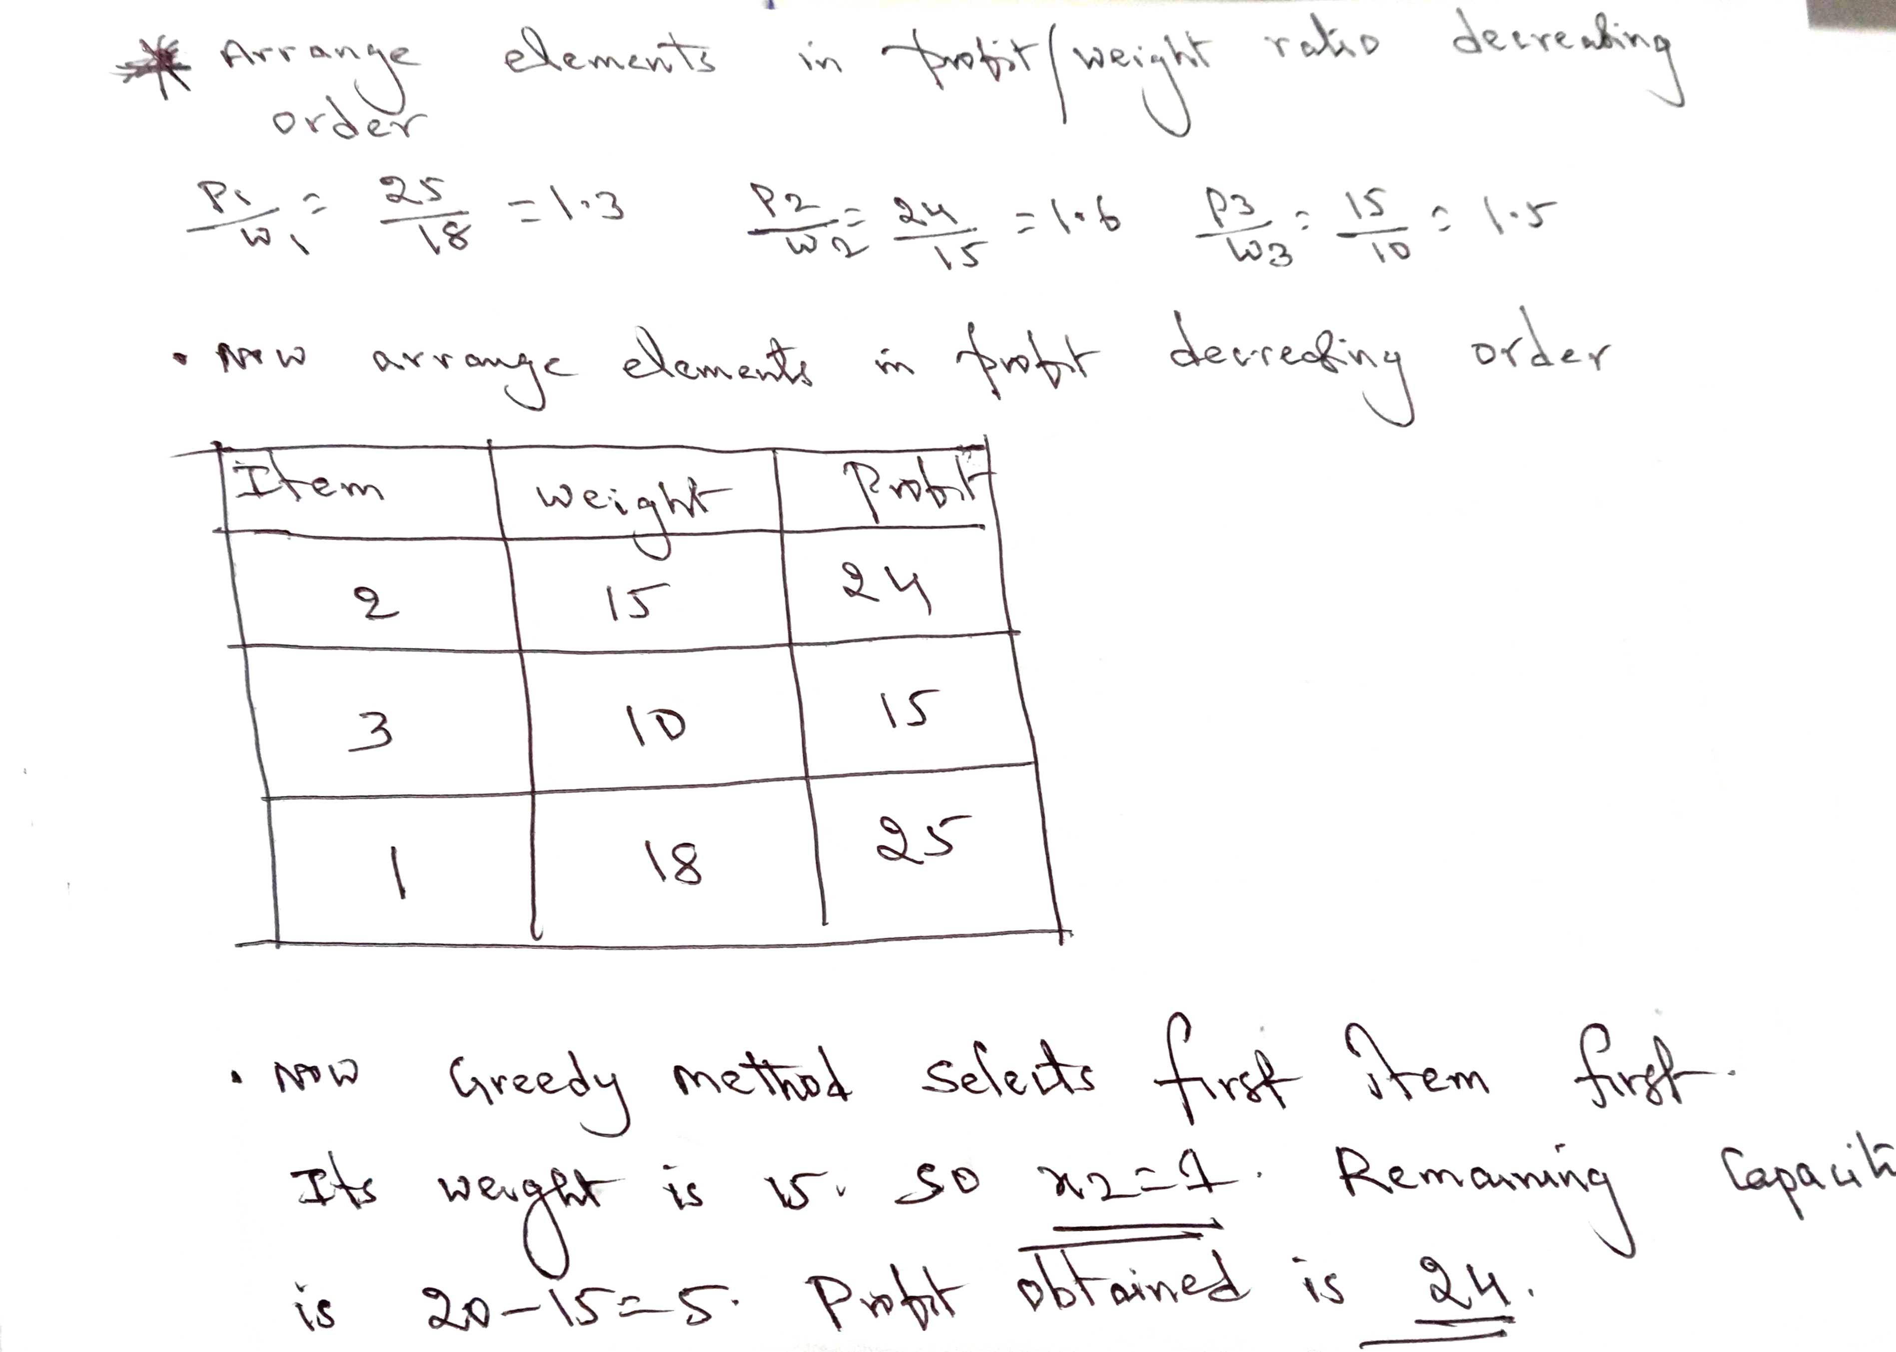
Knapsack Problem

Slide 10
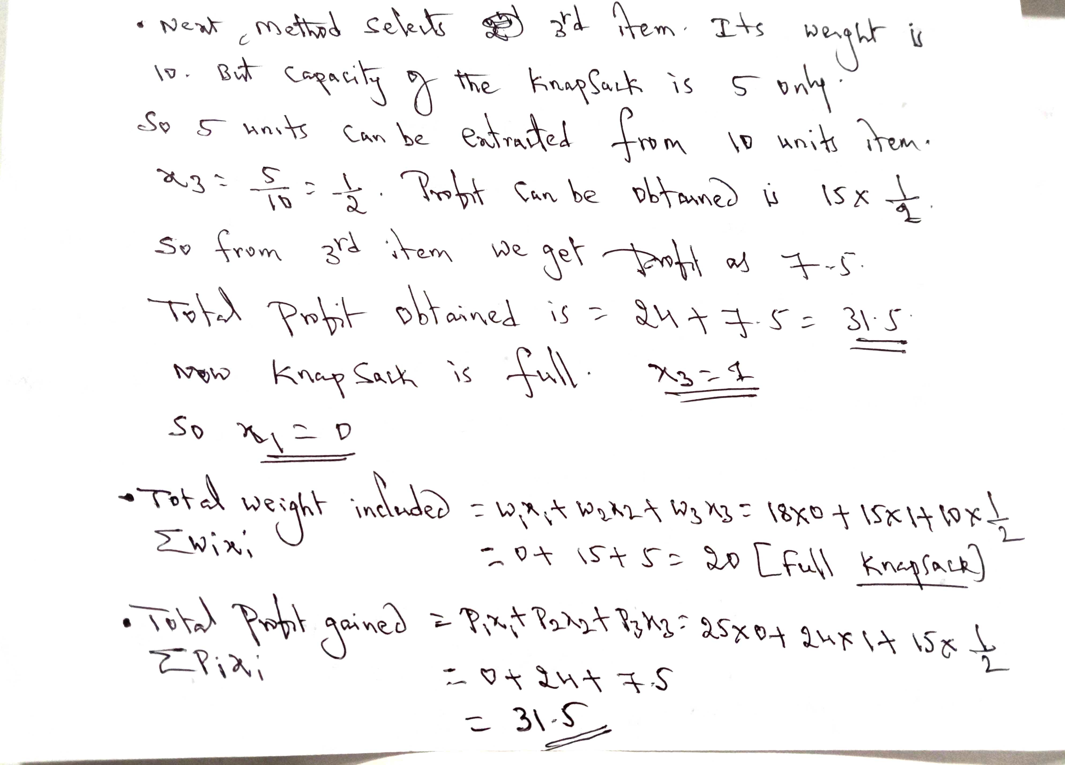
KnapSack Problem

Slide 11
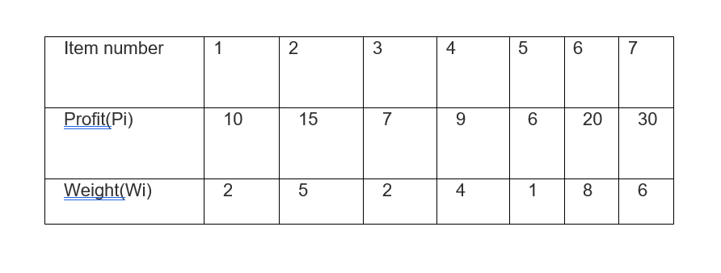
KNAPSACK PROBLEM
Example:
For the given set of items and knapsack capacity = 15 kg, find the optimal solution for the fractional knapsack problem making use of the greedy approach.

Slide 12
Solution: Straight Forward Greedy Approach:
Straight forward Greedy approach selects Highest profit item first. Item 7 has the highest profit with profit=30. weight is 6. total profit gaining after selecting item is 30. remaining knapsack capacity is 15-6=9. so x7=1.
Next maximum profit item is item 6 with profit 20.Total profit gained after selecting item is 30+20=50. The remaining knapsack capacity is 9- 8=1. and solution is x6=1.
Next maximum profit item is item 2 with profit 15. but the remaining capacity of knapsack is 1 unit. So extract 1 unit from item 2 (out of 5). So solution is x2=1/5. so the total profit gained is 50+15*1/5=53.
The solution is x1=0, x2=1/5, x3=0, x4=0, x5=0, x6=1, x7=1.
Total weight consumed in knapsack=15
Total profit obtained from the straight forward greedy approach is 53.

Slide 13
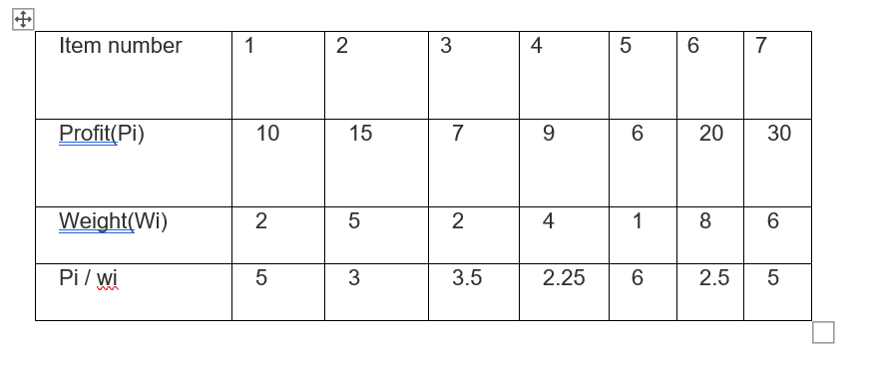
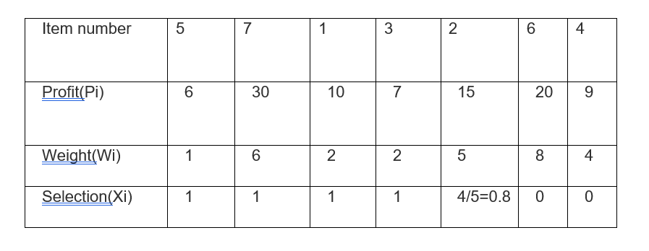
Solution: Find out profit per weight Pi/Wi
Arrange according to Pi/wi

Slide 14
Selection (Xi) Steps: let’s have the capacity m=15
The first profitable item we have are item no.5, so we select is 15-1=14. Now the remaining knapsack capacity is 14 and our selection is 1(means selected)
Then we have the next profitable item is item no .7 so we select 14-6. Now the remaining knapsack capacity is 8 and our selection is 1(means selected)
Then we have the next profitable item is item no .1 so we select 8-2. Now the remaining knapsack capacity is 6 and our selection is 1(means selected)
Then we have the next profitable item is item no .3 so we select 6-2. Now the remaining knapsack capacity is 4 and our selection is 1(means selected)
Then we have the next profitable item is item no .2. Its weight is 5 and our knapsack remaining capacity is 4, so now we are dealing with a greedy approach and select 4/5 items. (like take as we can )
So our selection is 4/5.
Now we don’t have any remaining capacity so we can’t take any more items, so it’s selection is made 0 for other items.

Slide 15
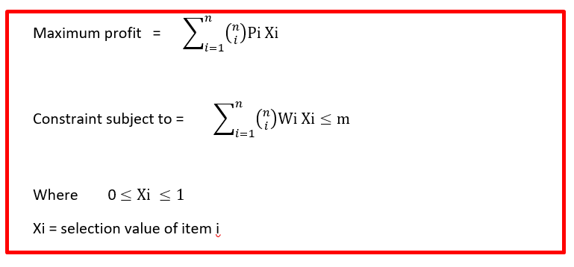
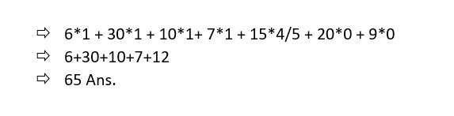
Formula:
The knapsack would contain the following items- < 5,7,1,3,2 >.
Knapsack’s total profit would be 65 units.

Slide 16
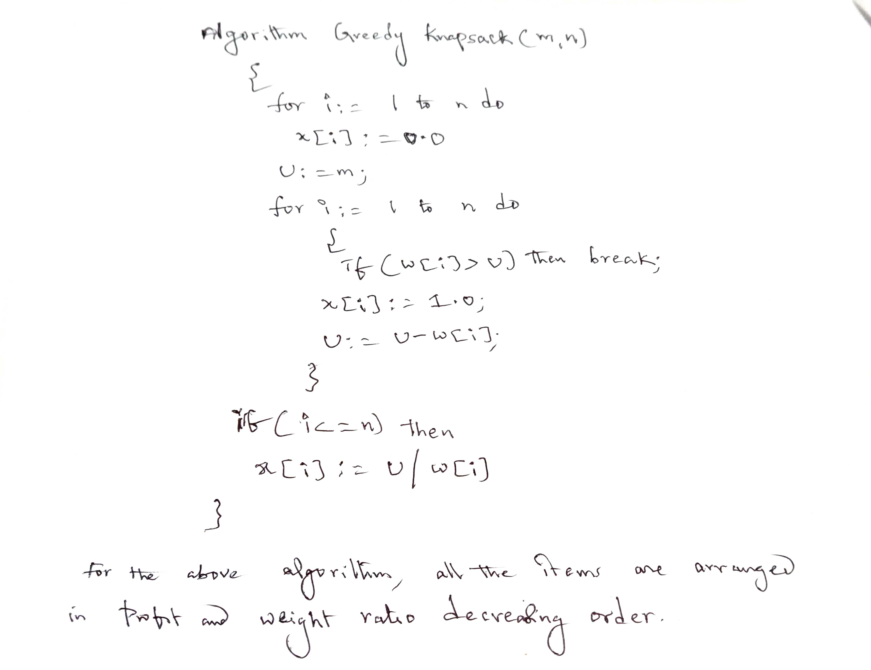

Slide 17
Job Sequencing with Deadlines Problem
Given a set of tasks with deadlines and total profit earned on completion of a task, find maximum profit earned by executing the tasks within the specified deadlines. Assume any task will take one unit of time to execute and any task can’t execute beyond its deadline. Also, one task can be executed at a time.
Example: Given the jobs, their deadlines and associated profits as shown below:
Jobs | J1 | J2 | J3 | J4 | J5 | J6
Deadlines | 5 | 3 | 3 | 2 | 4 | 2
Profits | 200 | 180 | 190 | 300 | 120 | 100

Slide 18
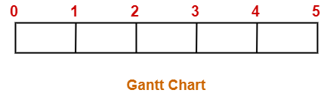
Step-01:
Sort all the given jobs in decreasing order of their profit-
Step-02:
Value of maximum deadline = 5. So, draw a Gantt chart with maximum time on Gantt chart = 5 units as shown-
Now, we take each job one by one in the order they appear in Step-01.We place the job on Gantt chart as far as possible from 0.
Jobs | J4 | J1 | J3 | J2 | J5 | J6
Deadlines | 2 | 5 | 3 | 3 | 4 | 2
Profits | 300 | 200 | 190 | 180 | 120 | 100

Slide 19
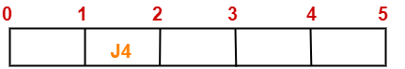
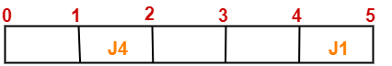
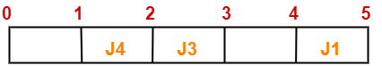
Step-03:
We take job J4. Since its deadline is 2, so we place it in the first empty cell before deadline 2 as-
Step-04:
We take job J1. Since its deadline is 5, so we place it in the first empty cell before deadline 5 as-
Step-05:
We take job J3. Since its deadline is 3, so we place it in the first empty cell before deadline 3 as-

Slide 20
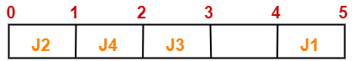
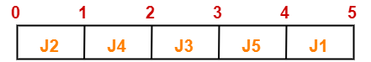
Step-06:
We take job J2. Since its deadline is 3, so we place it in the first empty cell before deadline 3. Since the second and third cells are already filled, so we place job J2 in the first cell as-
Step-07:
Now, we take job J5.Since its deadline is 4, so we place it in the first empty cell before deadline 4 as-
Now, The only job left is job J6 whose deadline is 2. All the slots before deadline 2 are already occupied. Thus, job J6 can not be completed.

Slide 21
The optimal schedule is- J2 , J4 , J3 , J5 , J1
This is the required order in which the jobs must be completed in order to obtain the maximum profit.
All the jobs are not completed in optimal schedule. This is because job J6 could not be completed within its deadline.
Maximum earned profit
= Sum of profit of all the jobs in optimal schedule
= Profit of job J2 + Profit of job J4 + Profit of job J3 + Profit of job J5 + Profit of job J1
= 180 + 300 + 190 + 120 + 200= 990 units

Slide 22
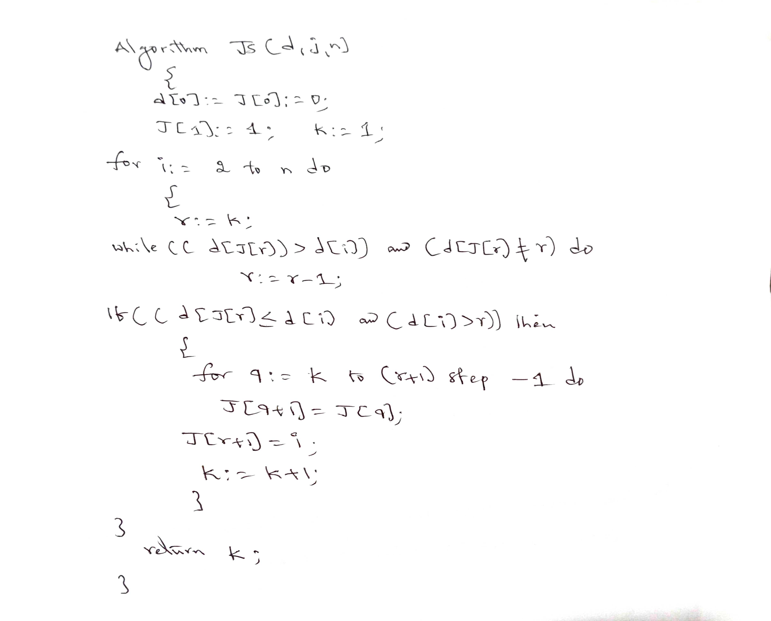

Slide 23
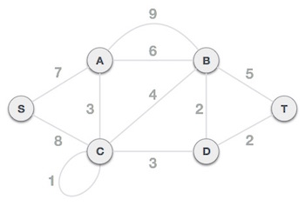
Minimum Cost Spanning Tree
A Minimum Spanning Tree (MST) is a subset of edges of a connected weighted undirected graph that connects all the vertices together with the minimum possible total edge weight. To derive an MST, Prim’s algorithm or Kruskal’s algorithm can be used.
Prims Algorithm: Prim’s algorithm is a greedy approach to find the minimum spanning tree. In this algorithm, to form a MST we can start from an arbitrary vertex.

Slide 24
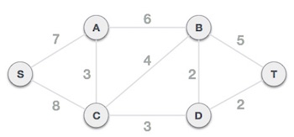
Minimum Cost Spanning Tree
Step 1 - Remove all loops and parallel edges : Remove all loops and parallel edges from the given graph. In case of parallel edges, keep the one which has the least cost associated and remove all others.
Step 2 - Choose any arbitrary node as root node
In this case, we choose S node as the root node of Prim's spanning tree. This node is arbitrarily chosen, so any node can be the root node. One may wonder why any video can be a root node. So the answer is, in the spanning tree all the nodes of a graph are included and because it is connected then there must be at least one edge, which will join it to the rest of the tree.

Slide 25
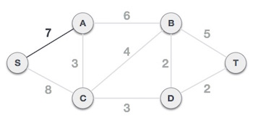
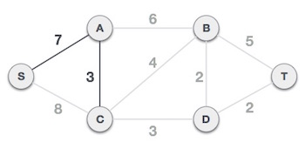
Minimum Cost Spanning Tree
Step 3 - Check outgoing edges and select the one with less cost : After choosing the root node S, we see that S,A and S,C are two edges with weight 7 and 8, respectively. We choose the edge S,A as it is lesser than the other.
Now, the tree S-7-A is treated as one node and we check for all edges going out from it. We select the one which has the lowest cost and include it in the tree.

Slide 26
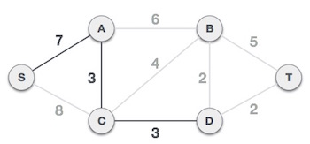
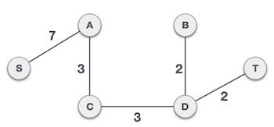
Minimum Cost Spanning Tree
After this step, S-7-A-3-C tree is formed. Now we'll again treat it as a node and will check all the edges again. However, we will choose only the least cost edge. In this case, C-3-D is the new edge, which is less than other edges' cost 8, 6, 4, etc.
After adding node D to the spanning tree, we now have two edges going out of it having the same cost, i.e. D-2-T and D-2-B. Thus, we can add either one. But the next step will again yield edge 2 as the least cost. Hence, we are showing a spanning tree with both edges included.

Slide 27
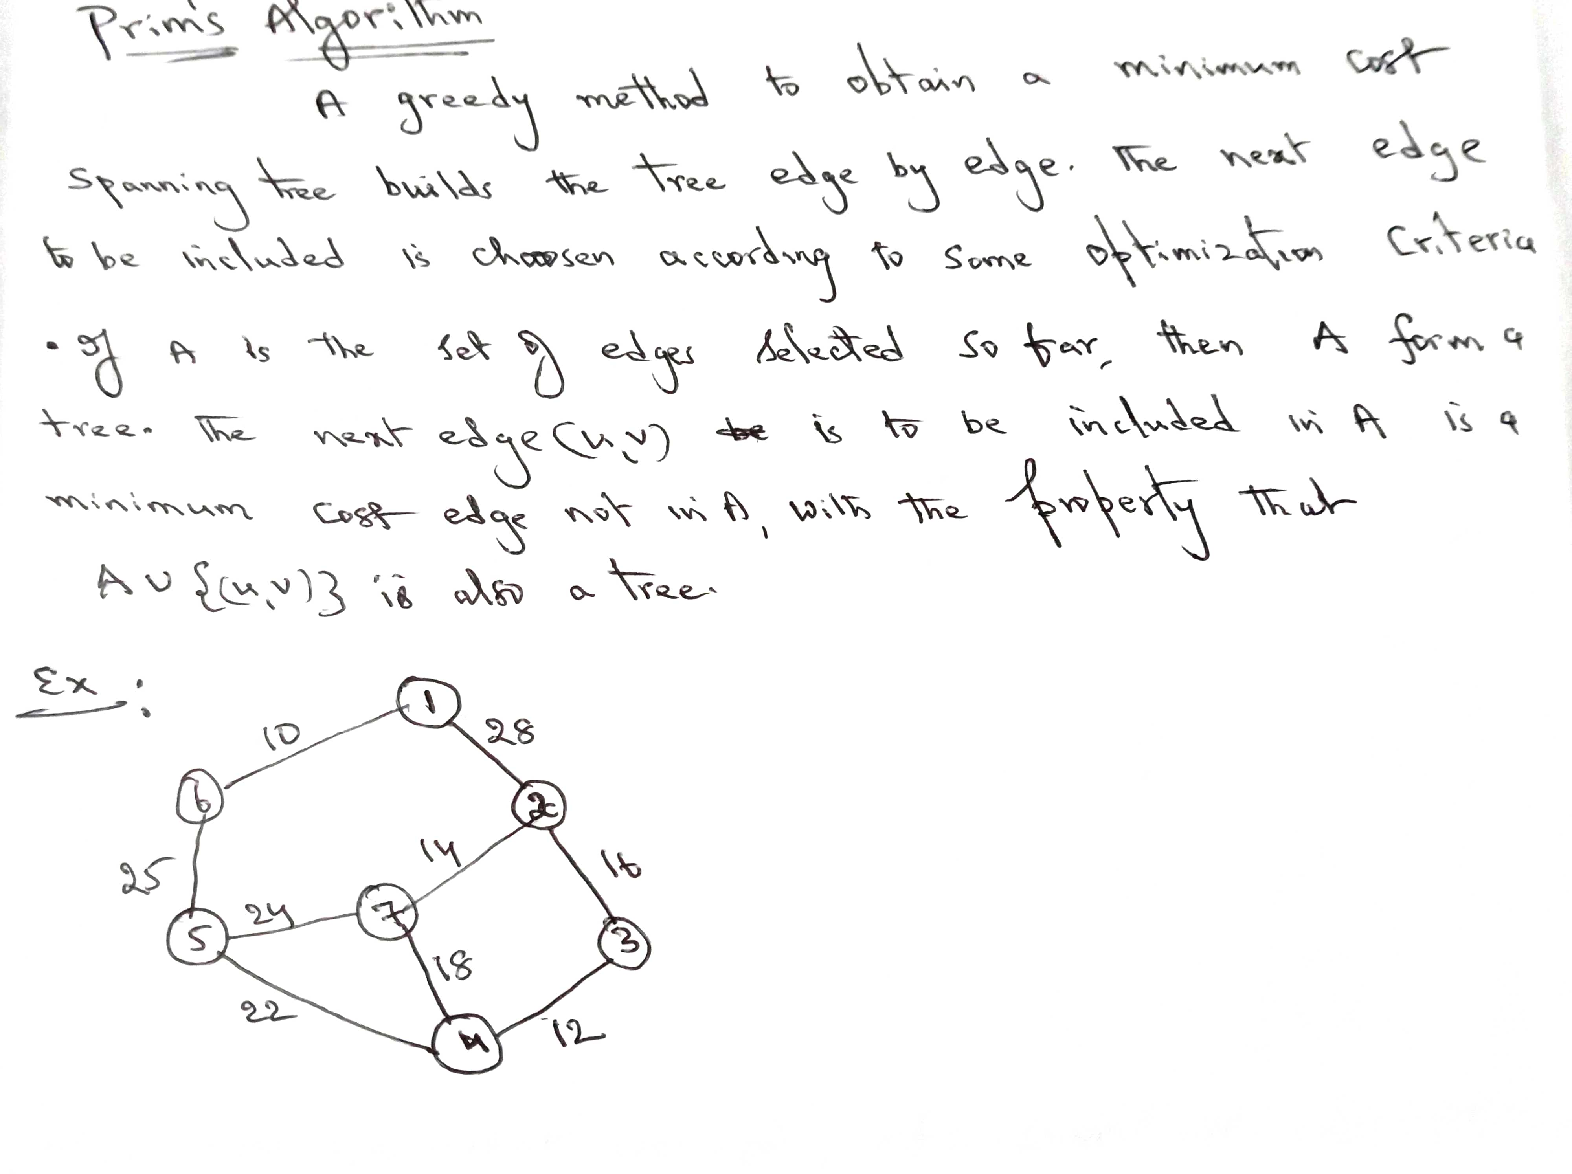
Minimum Cost Spanning Tree

Slide 28
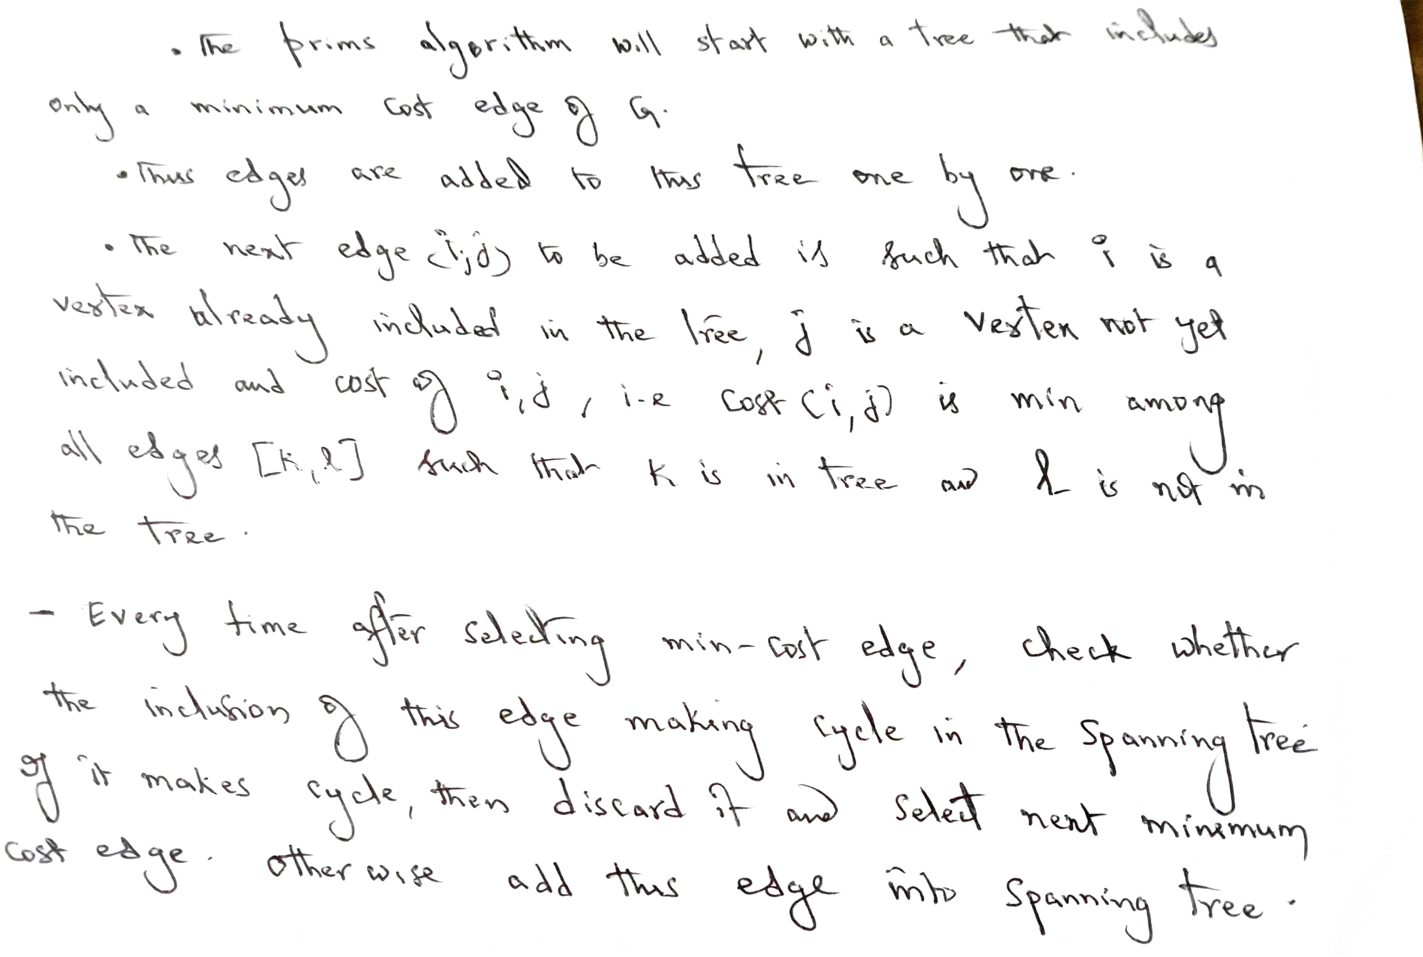
Minimum Cost Spanning Tree

Slide 29
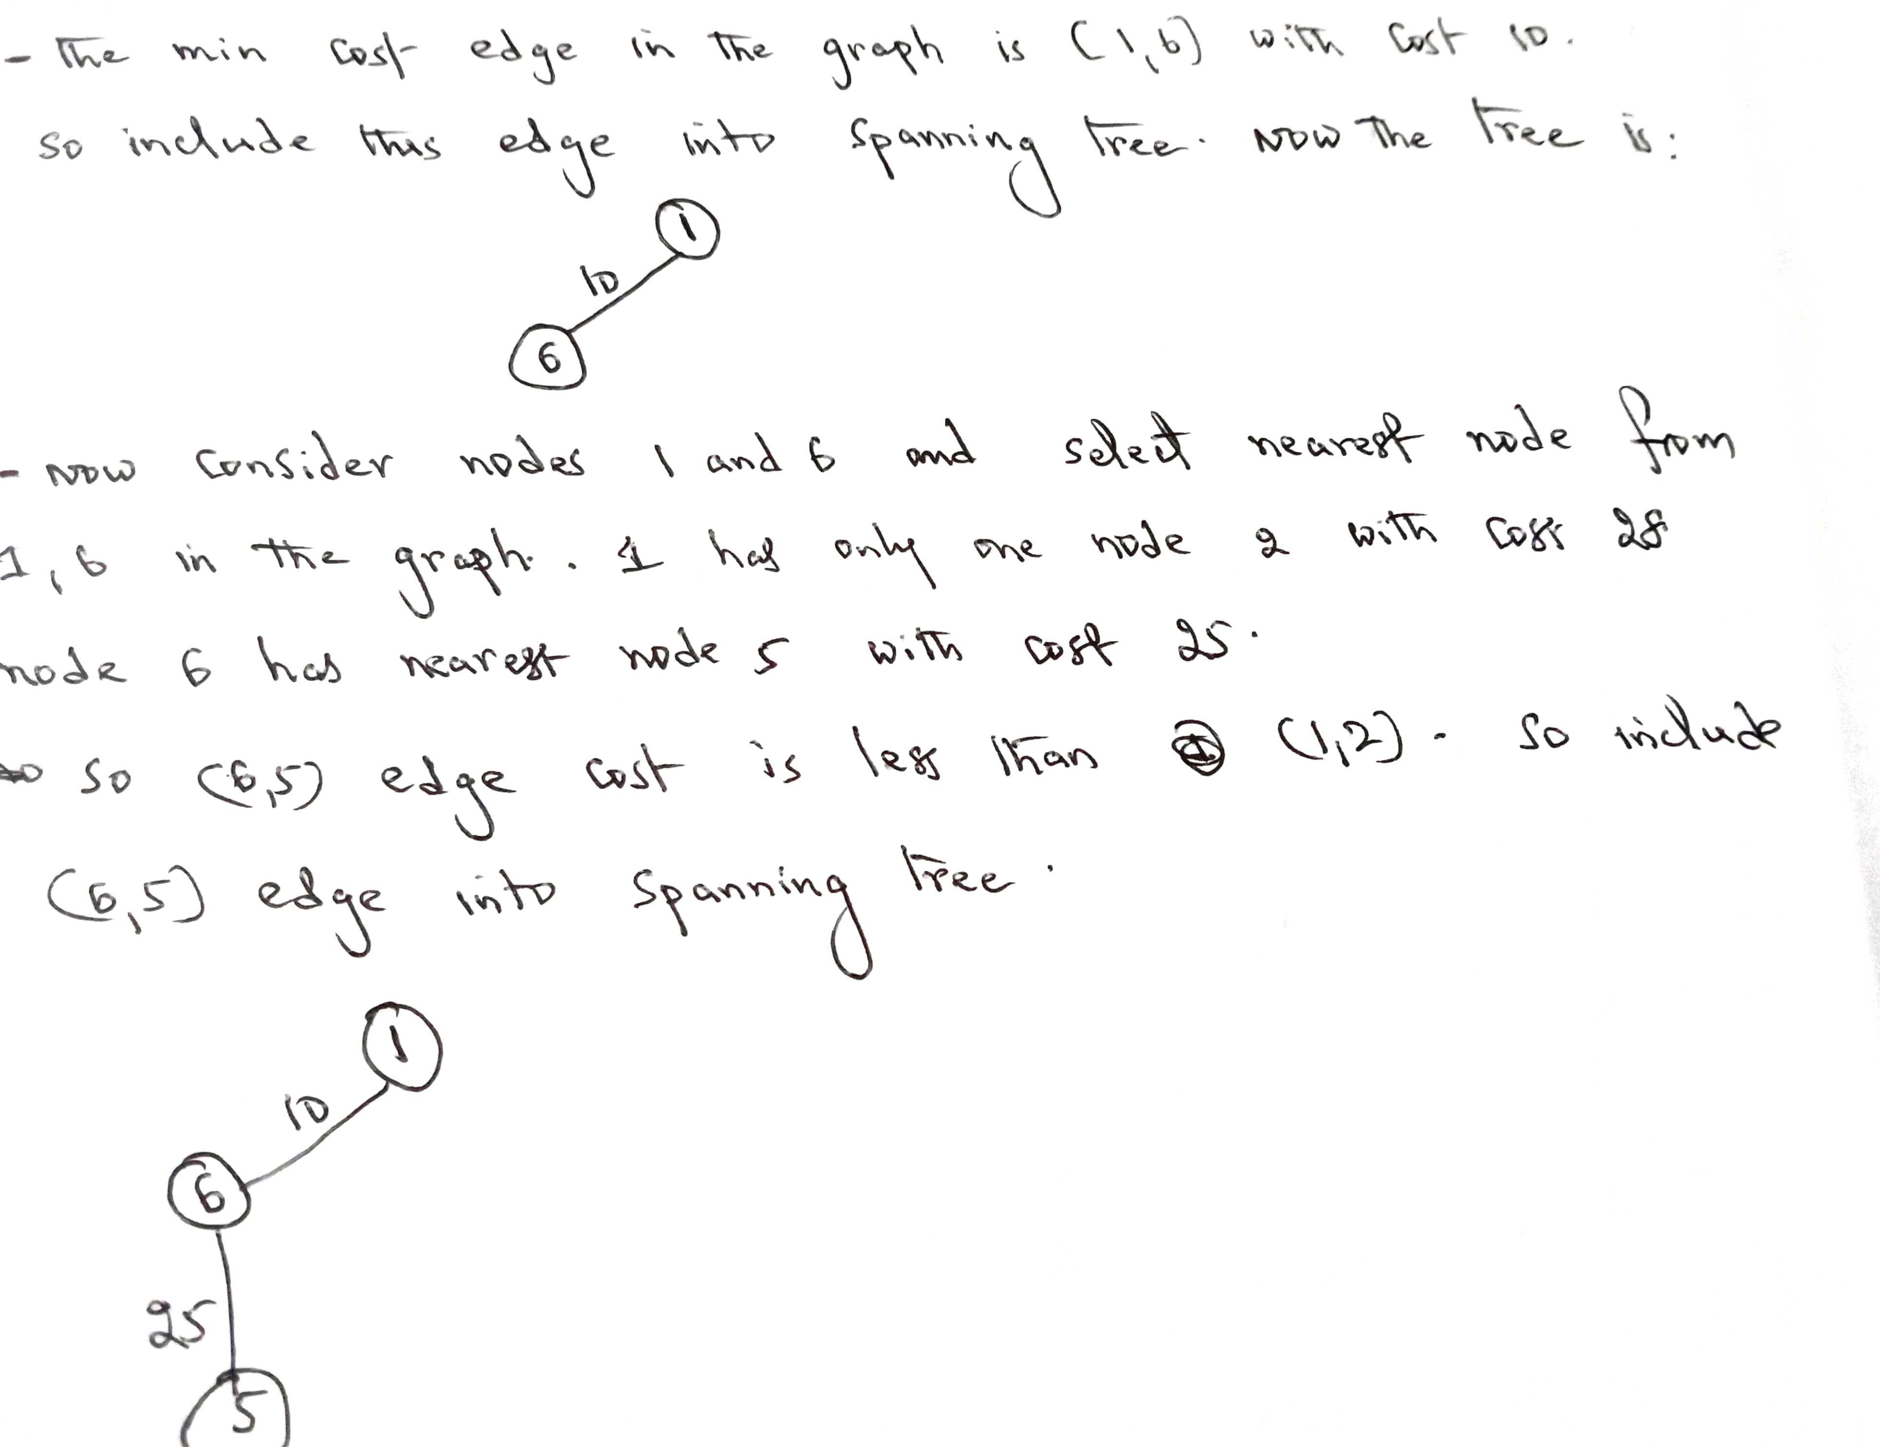
Minimum Cost Spanning Tree

Slide 30
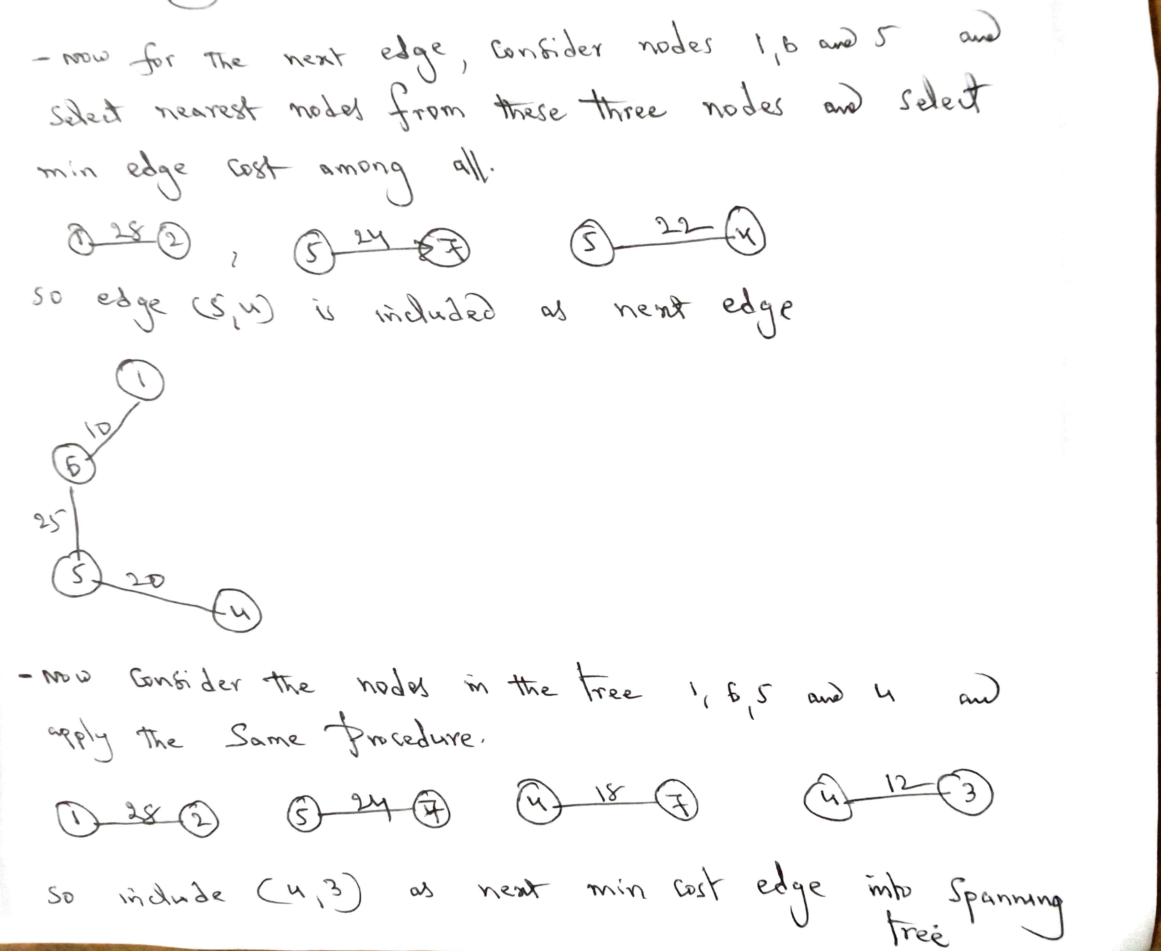
Minimum Cost Spanning Tree

Slide 31
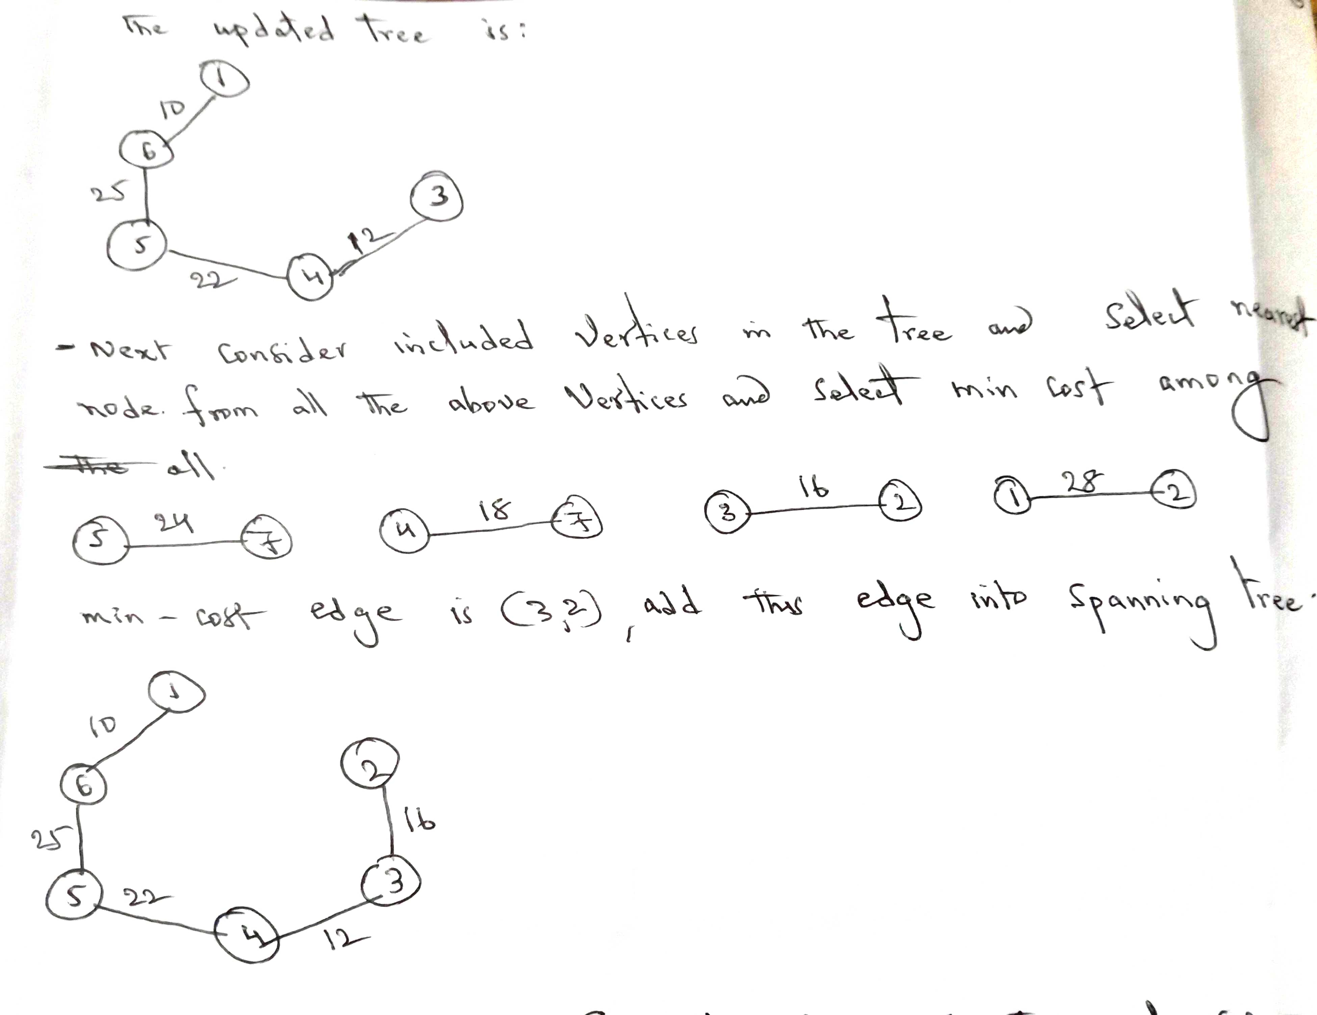
Minimum Cost Spanning Tree

Slide 32
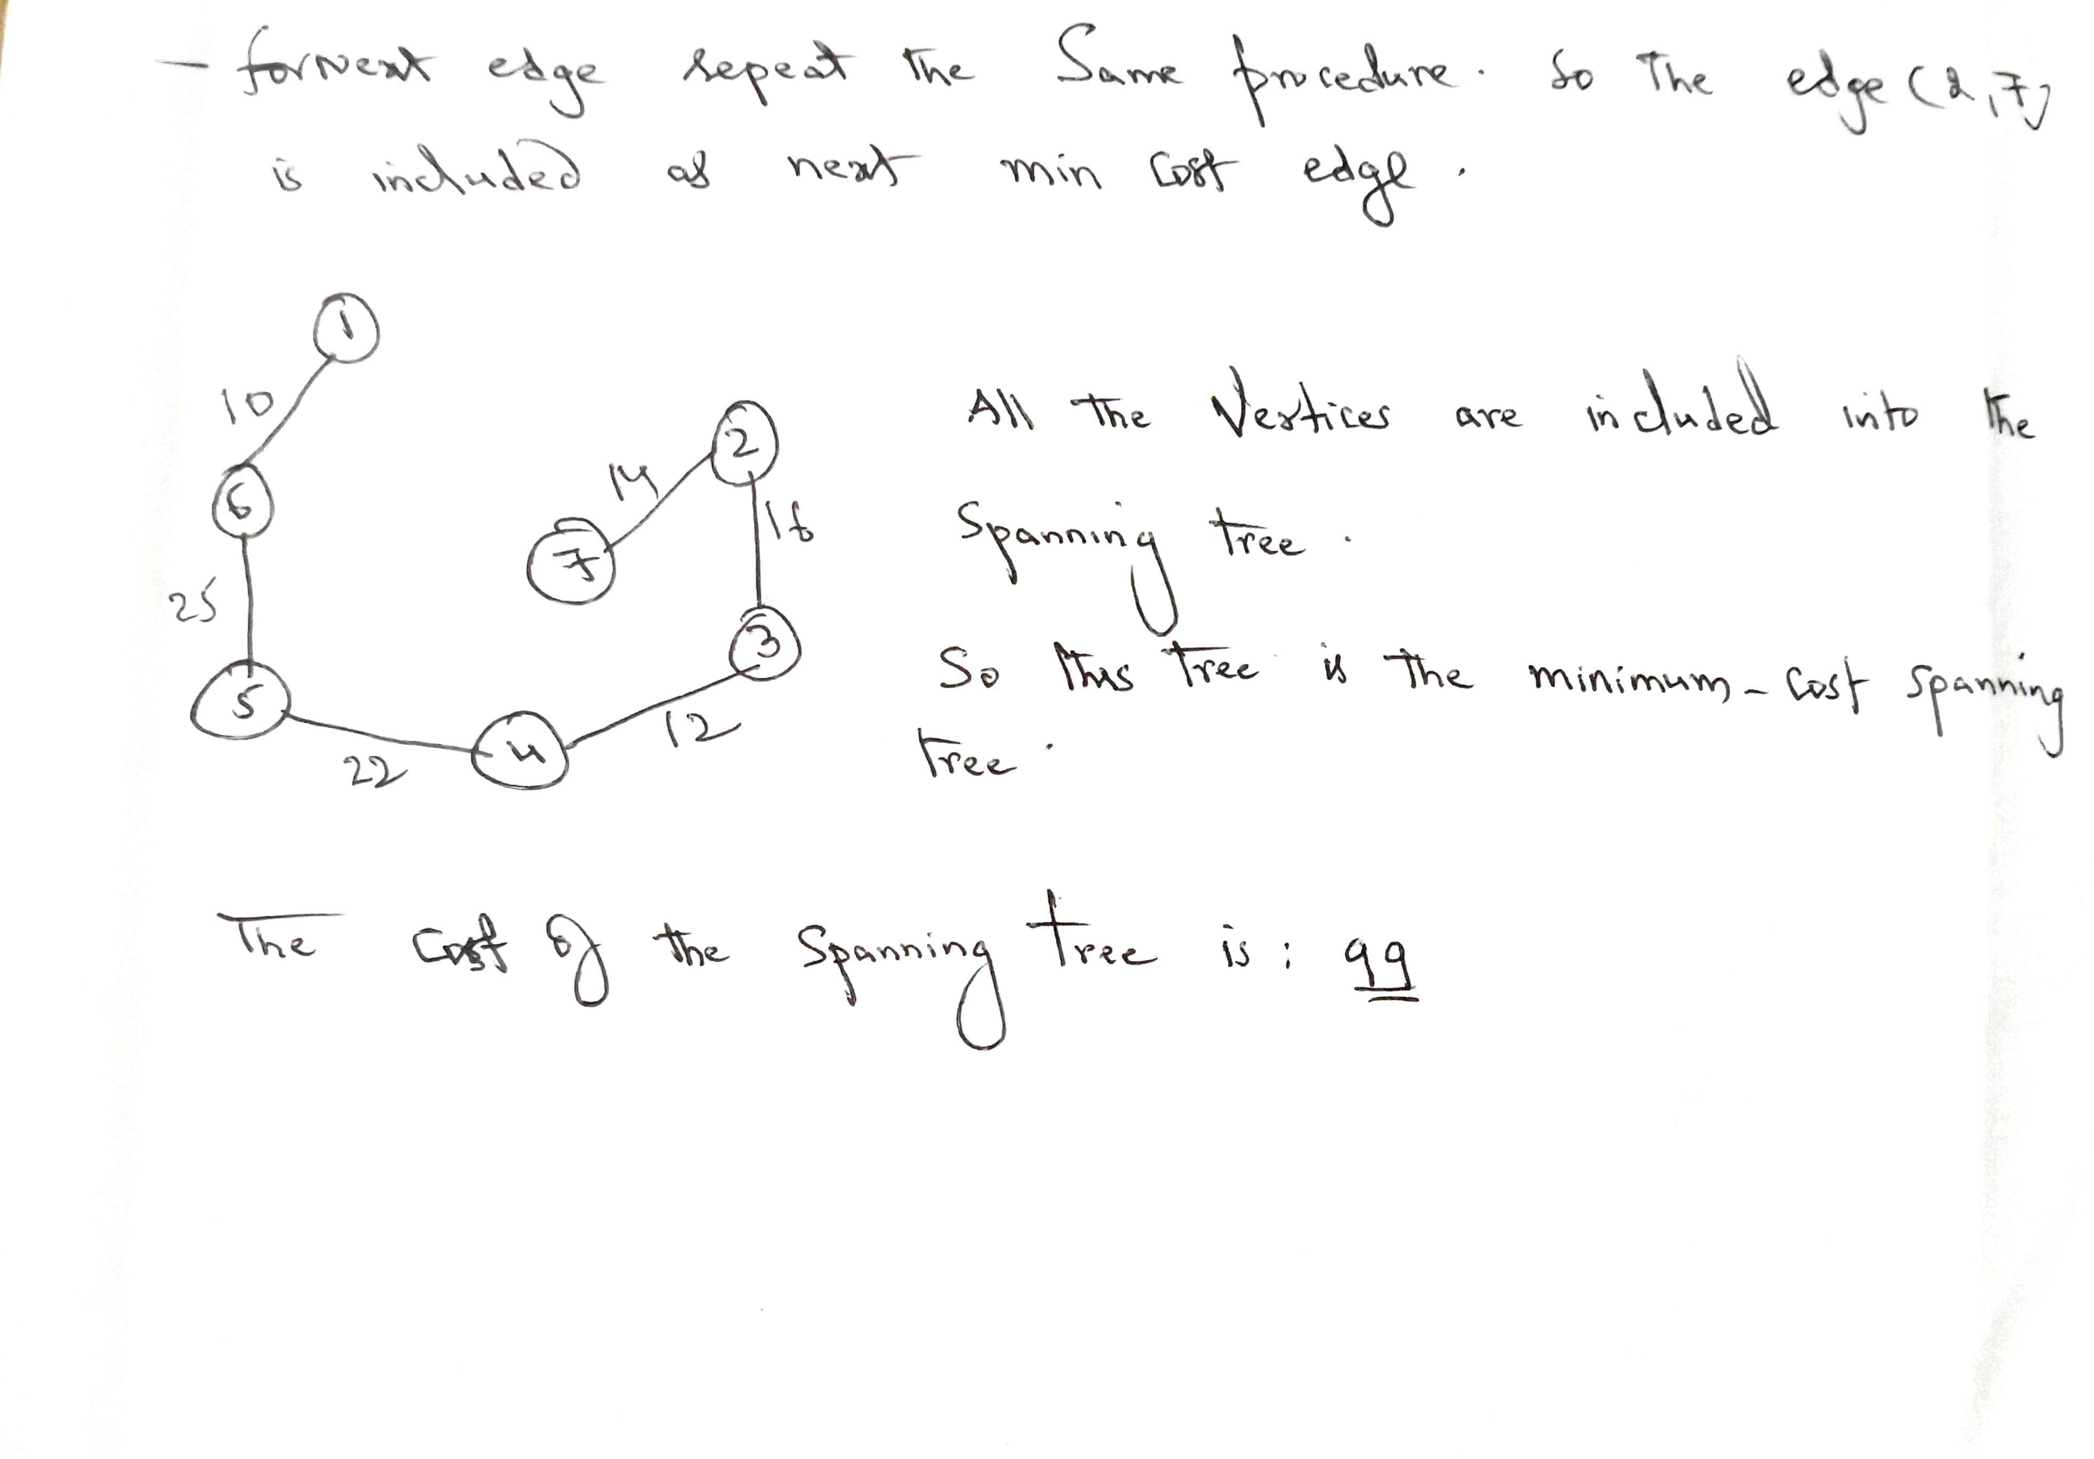
Minimum Cost Spanning Tree

Slide 33
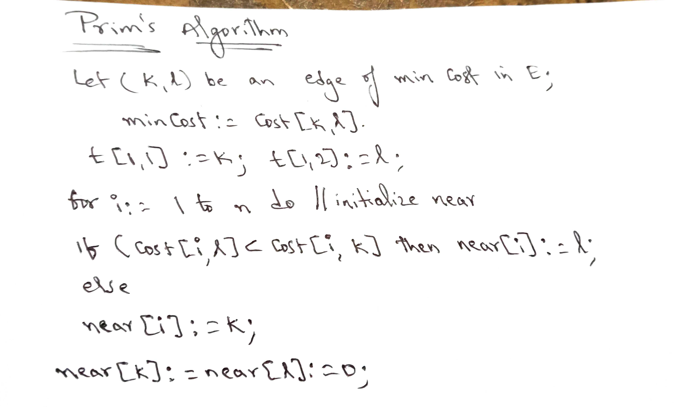
Minimum Cost Spanning Tree

Slide 34
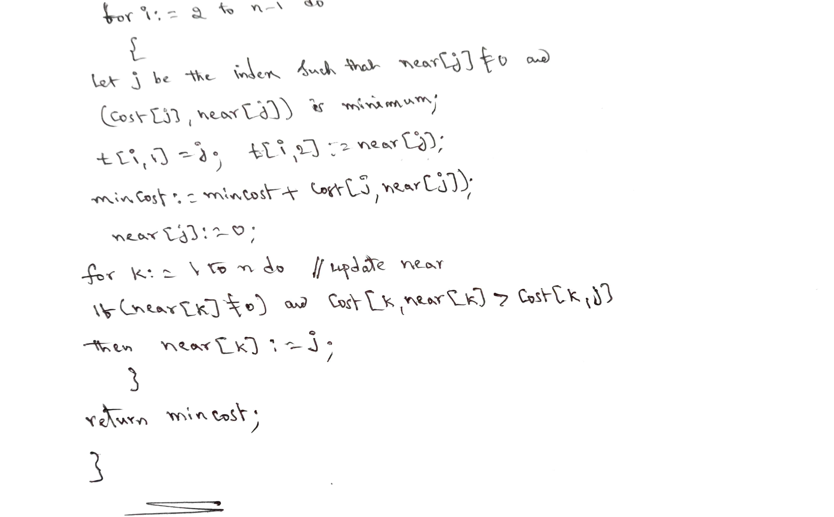
Minimum Cost Spanning Tree

Slide 35
Minimum Cost Spanning Tree
Kruskal’s Algorithm: Kruskal's algorithm to find the minimum cost spanning tree uses the greedy approach. This algorithm treats the graph as a forest and every node it has as an individual tree. A tree connects to another only and only if, it has the least cost among all available options and does not violate MST properties.
To understand Kruskal's algorithm let us consider the following example −

Slide 36
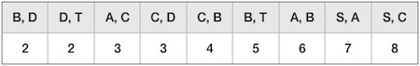
Minimum Cost Spanning Tree
Step 1 - Remove all loops and Parallel Edges : Remove all loops and parallel edges from the given graph.
Step 2 - Arrange all edges in their increasing order of weight : The next step is to create a set of edges and weight, and arrange them in an ascending order of weightage (cost).

Slide 37
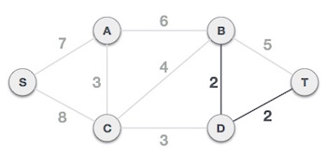
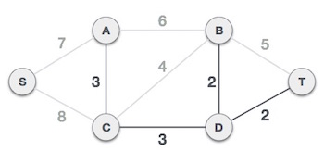
Minimum Cost Spanning Tree
Step 3 - Add the edge which has the least weightage : Now we start adding edges to the graph beginning from the one which has the least weight. Throughout, we shall keep checking that the spanning properties remain intact. In case, by adding one edge, the spanning tree property does not hold then we shall consider not to include the edge in the graph.
The least cost is 2 and edges involved are B,D and D,T. We add them. Adding them does not violate spanning tree properties, so we continue to our next edge selection.
Next cost is 3, and associated edges are A,C and C,D. We add them again −

Slide 38
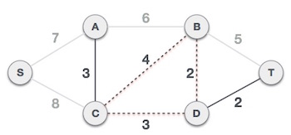
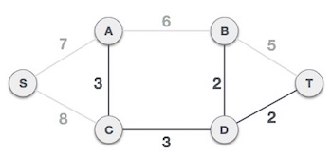
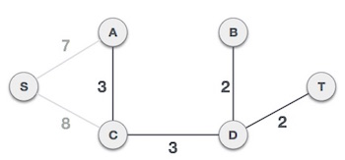
Minimum Cost Spanning Tree
Next cost in the table is 4, and we observe that adding it will create a circuit in the graph. −
We ignore it. In the process we shall ignore/avoid all edges that create a circuit.
We observe that edges with cost 5 and 6 also create circuits. We ignore them and move on.

Slide 39
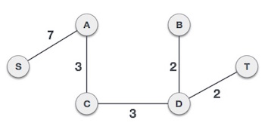
Minimum Cost Spanning Tree
Now we are left with only one node to be added. Between the two least cost edges available 7 and 8, we shall add the edge with cost 7.
By adding edge S,A we have included all the nodes of the graph and we now have minimum cost spanning tree.

Slide 40
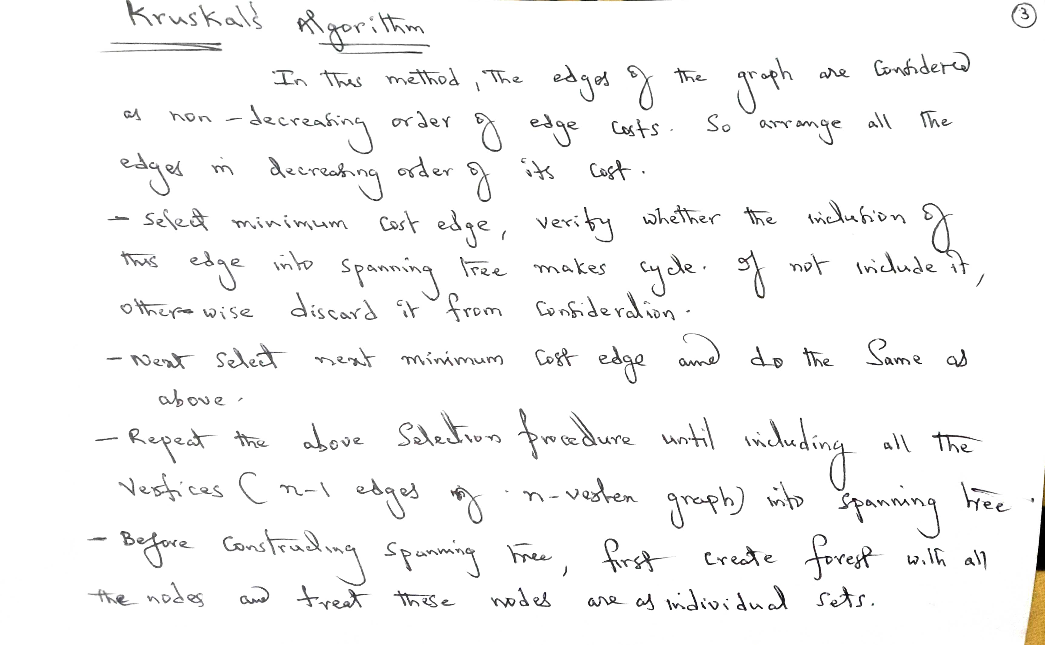
Minimum Cost Spanning Tree

Slide 41
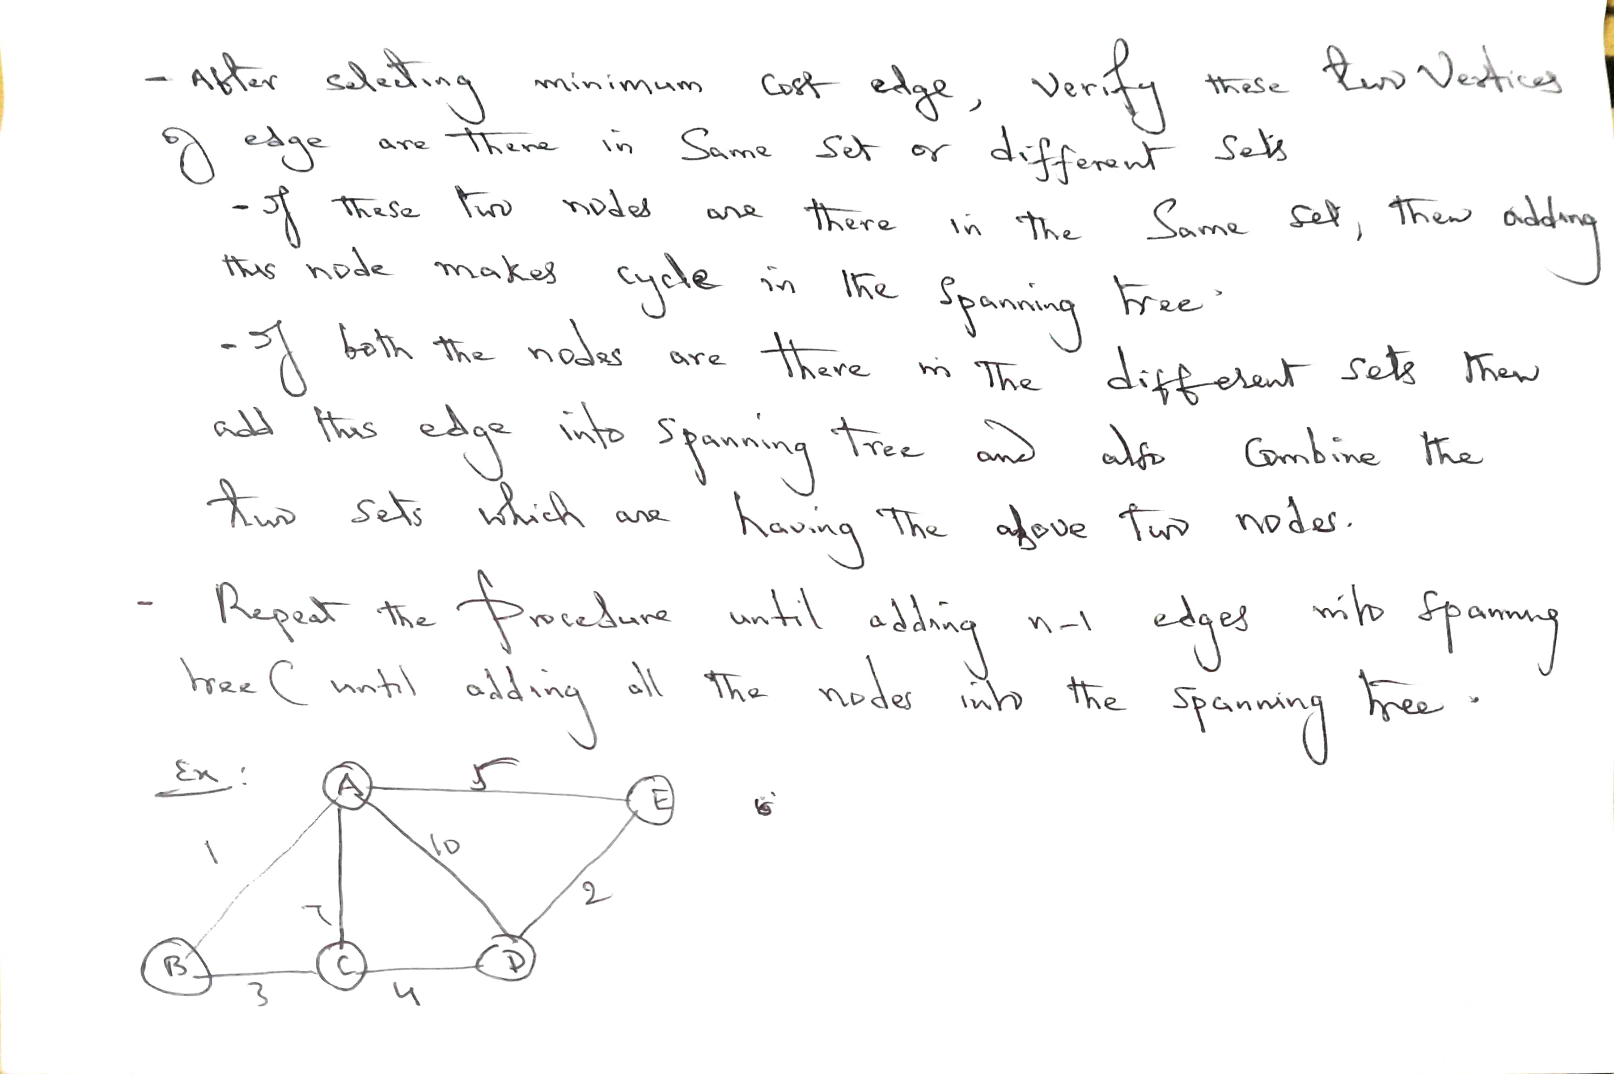
Minimum Cost Spanning Tree

Slide 42
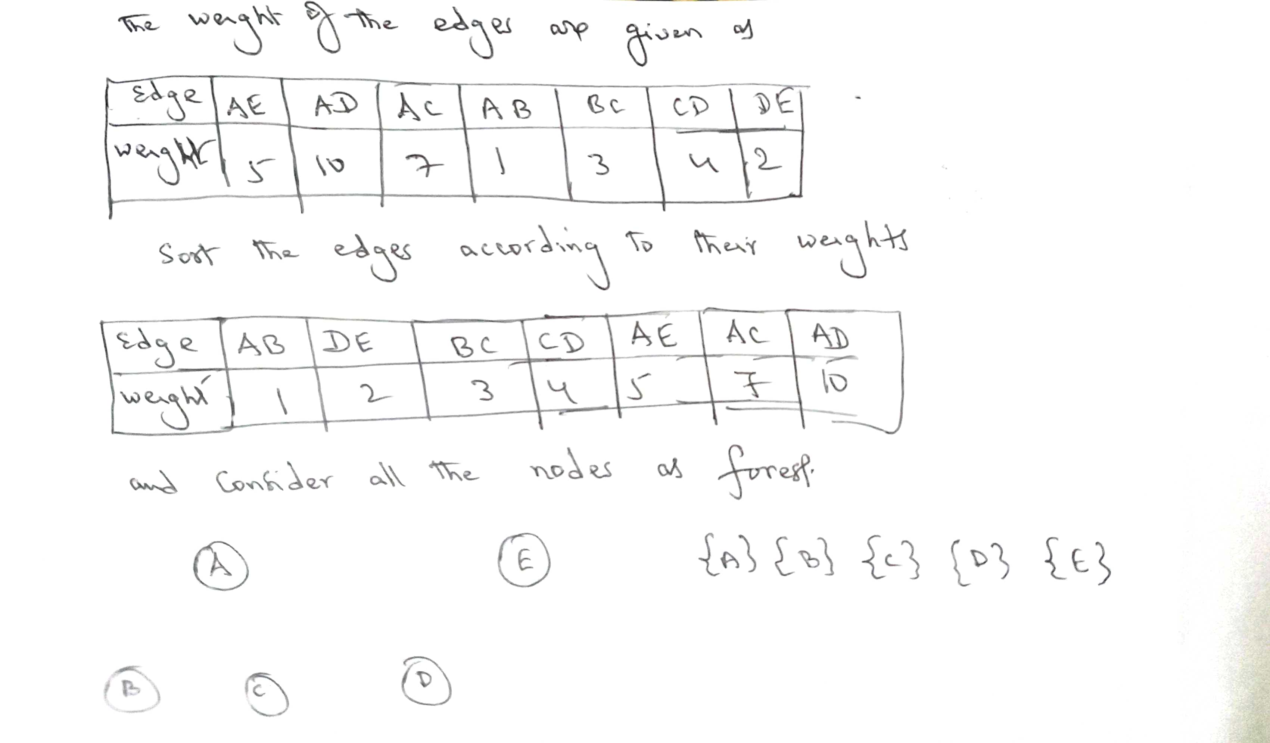
Minimum Cost Spanning Tree

Slide 43
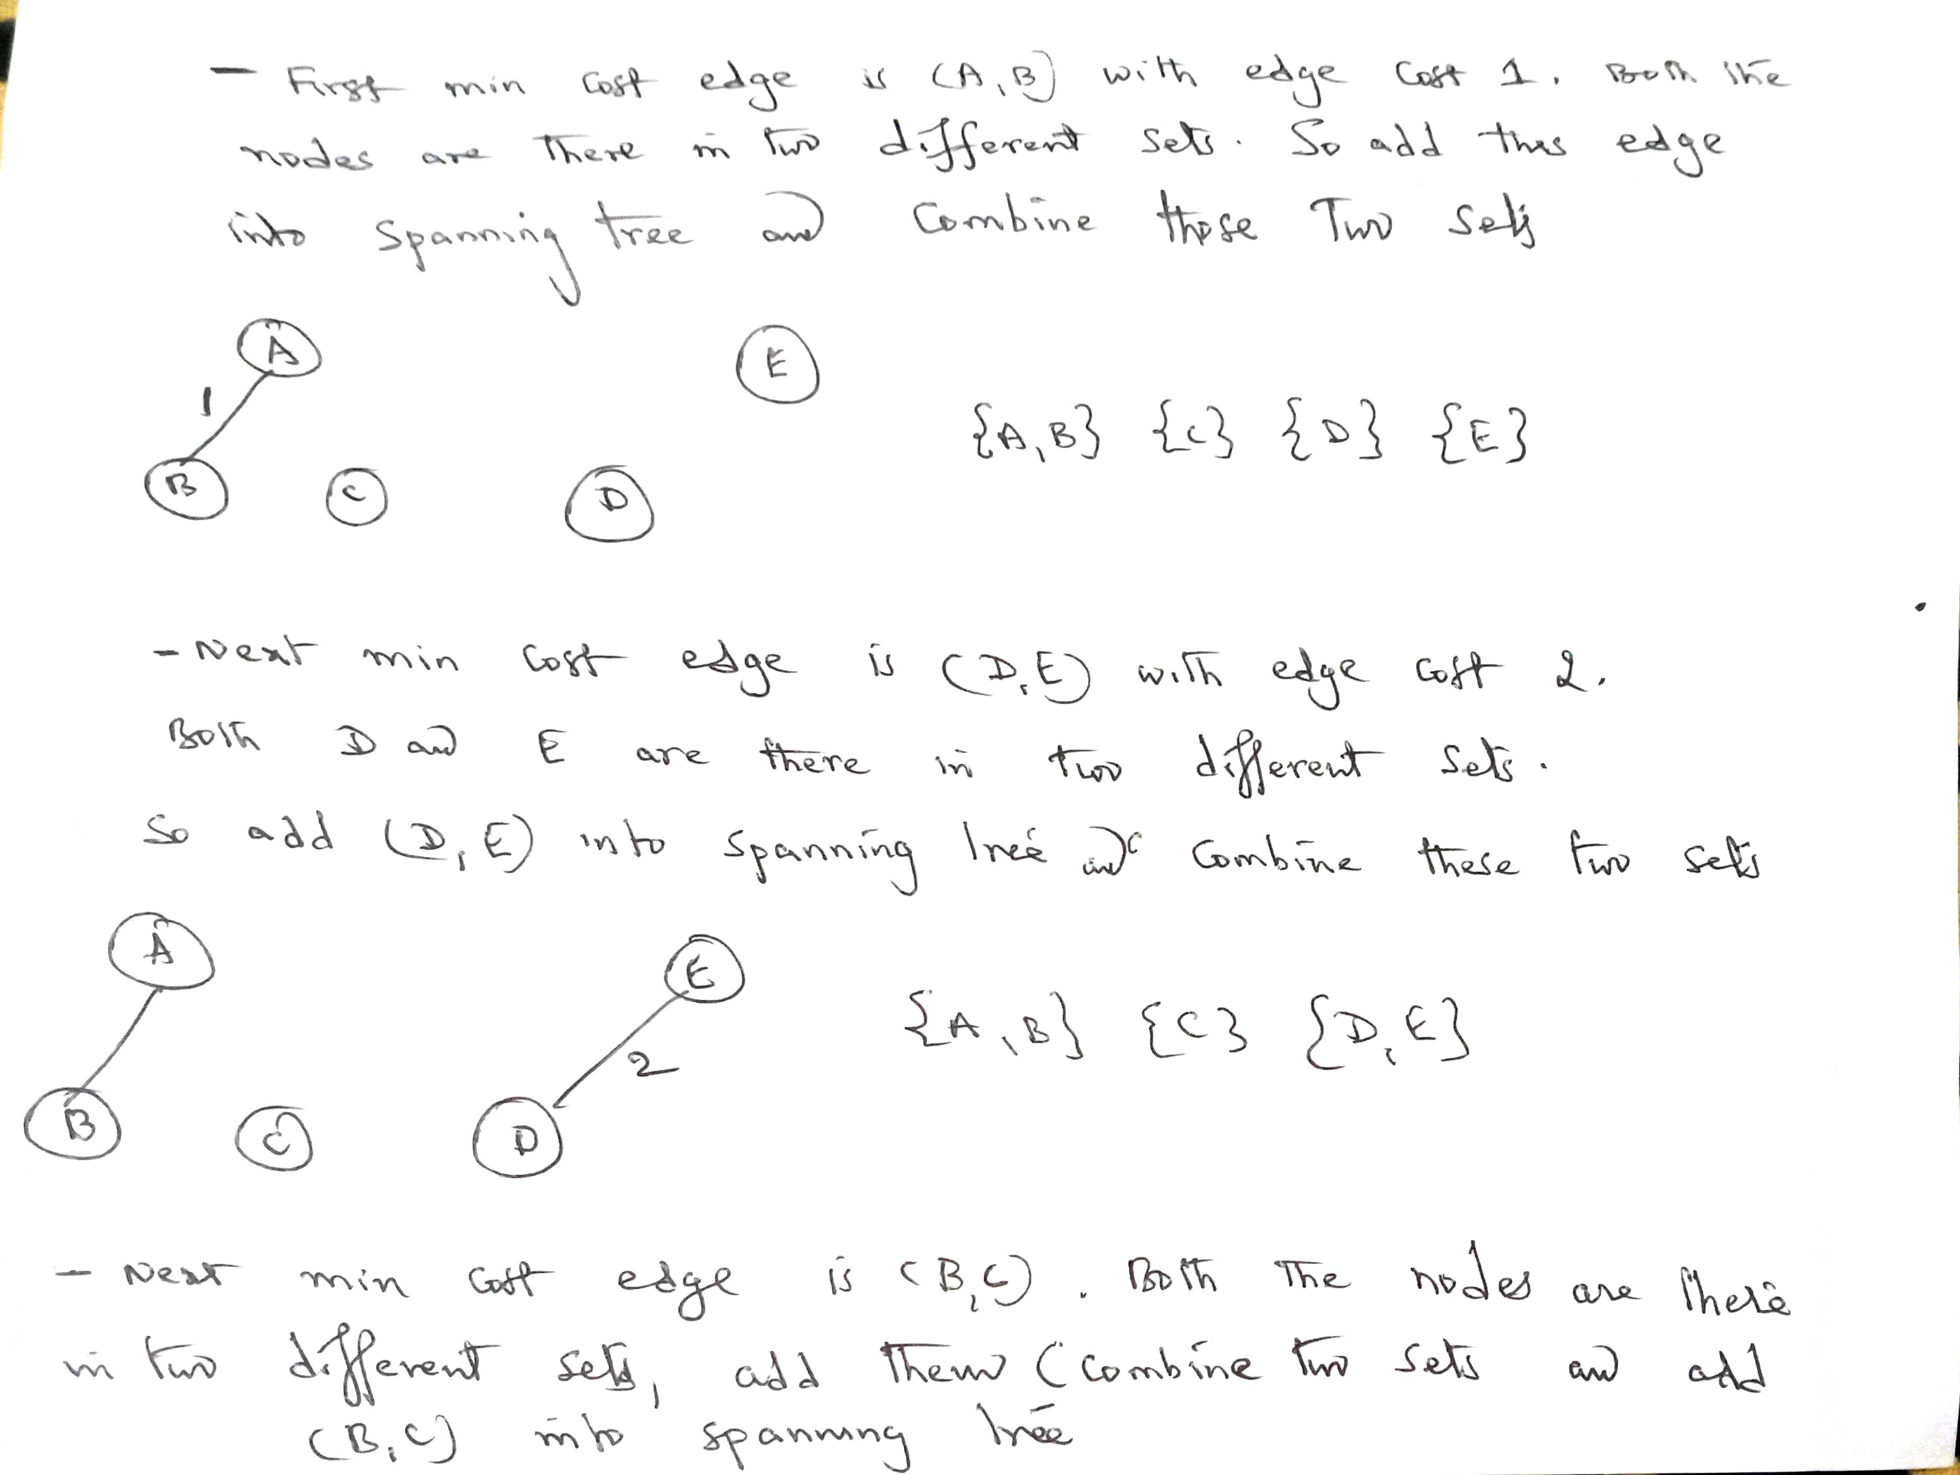
Minimum Cost Spanning Tree

Slide 44
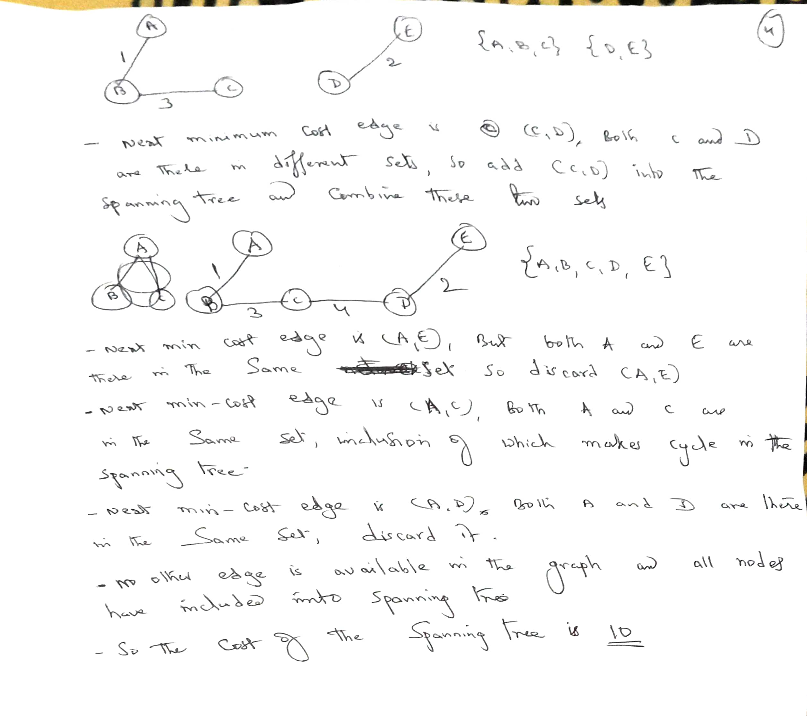
Minimum Cost Spanning Tree

Slide 45
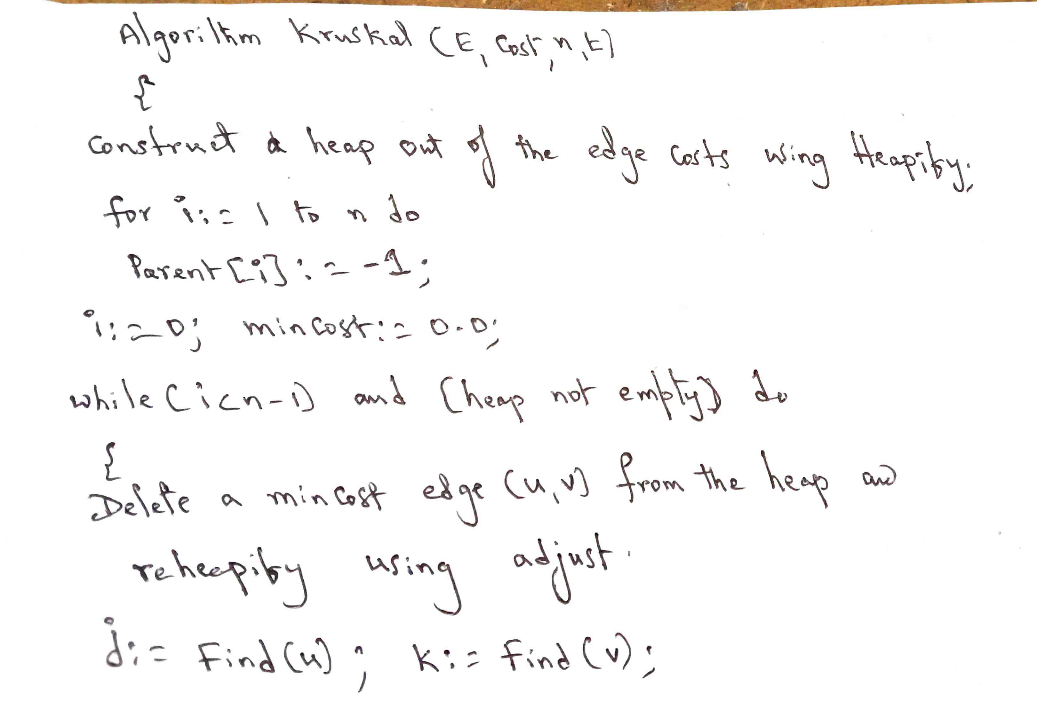
Minimum Cost Spanning Tree

Slide 46
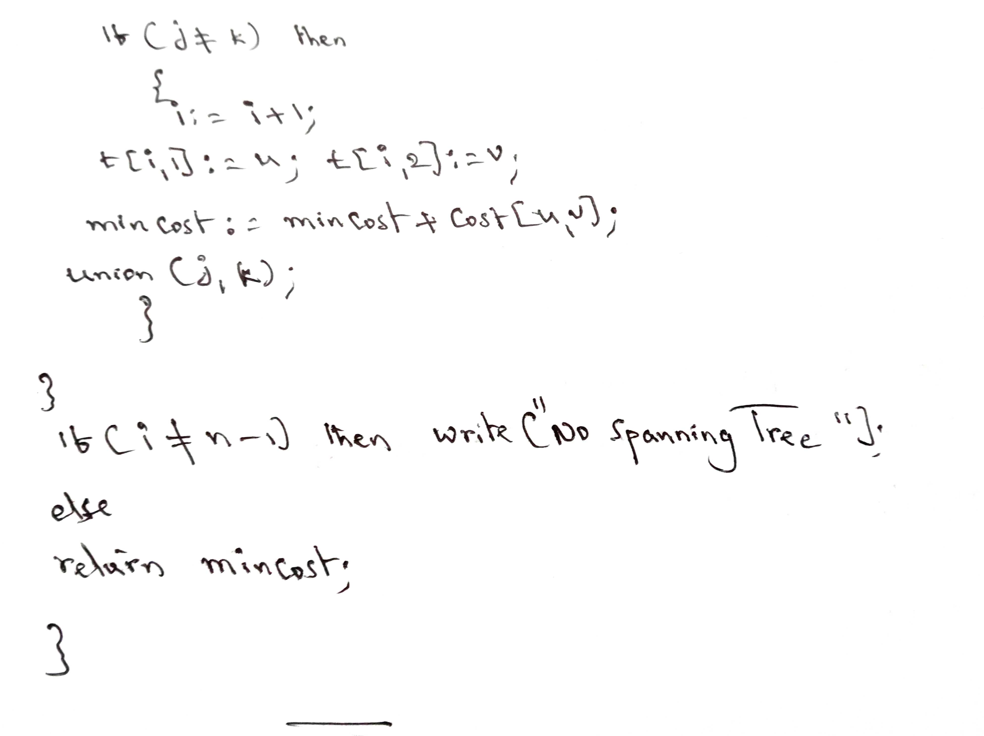
Minimum Cost Spanning Tree

Slide 47
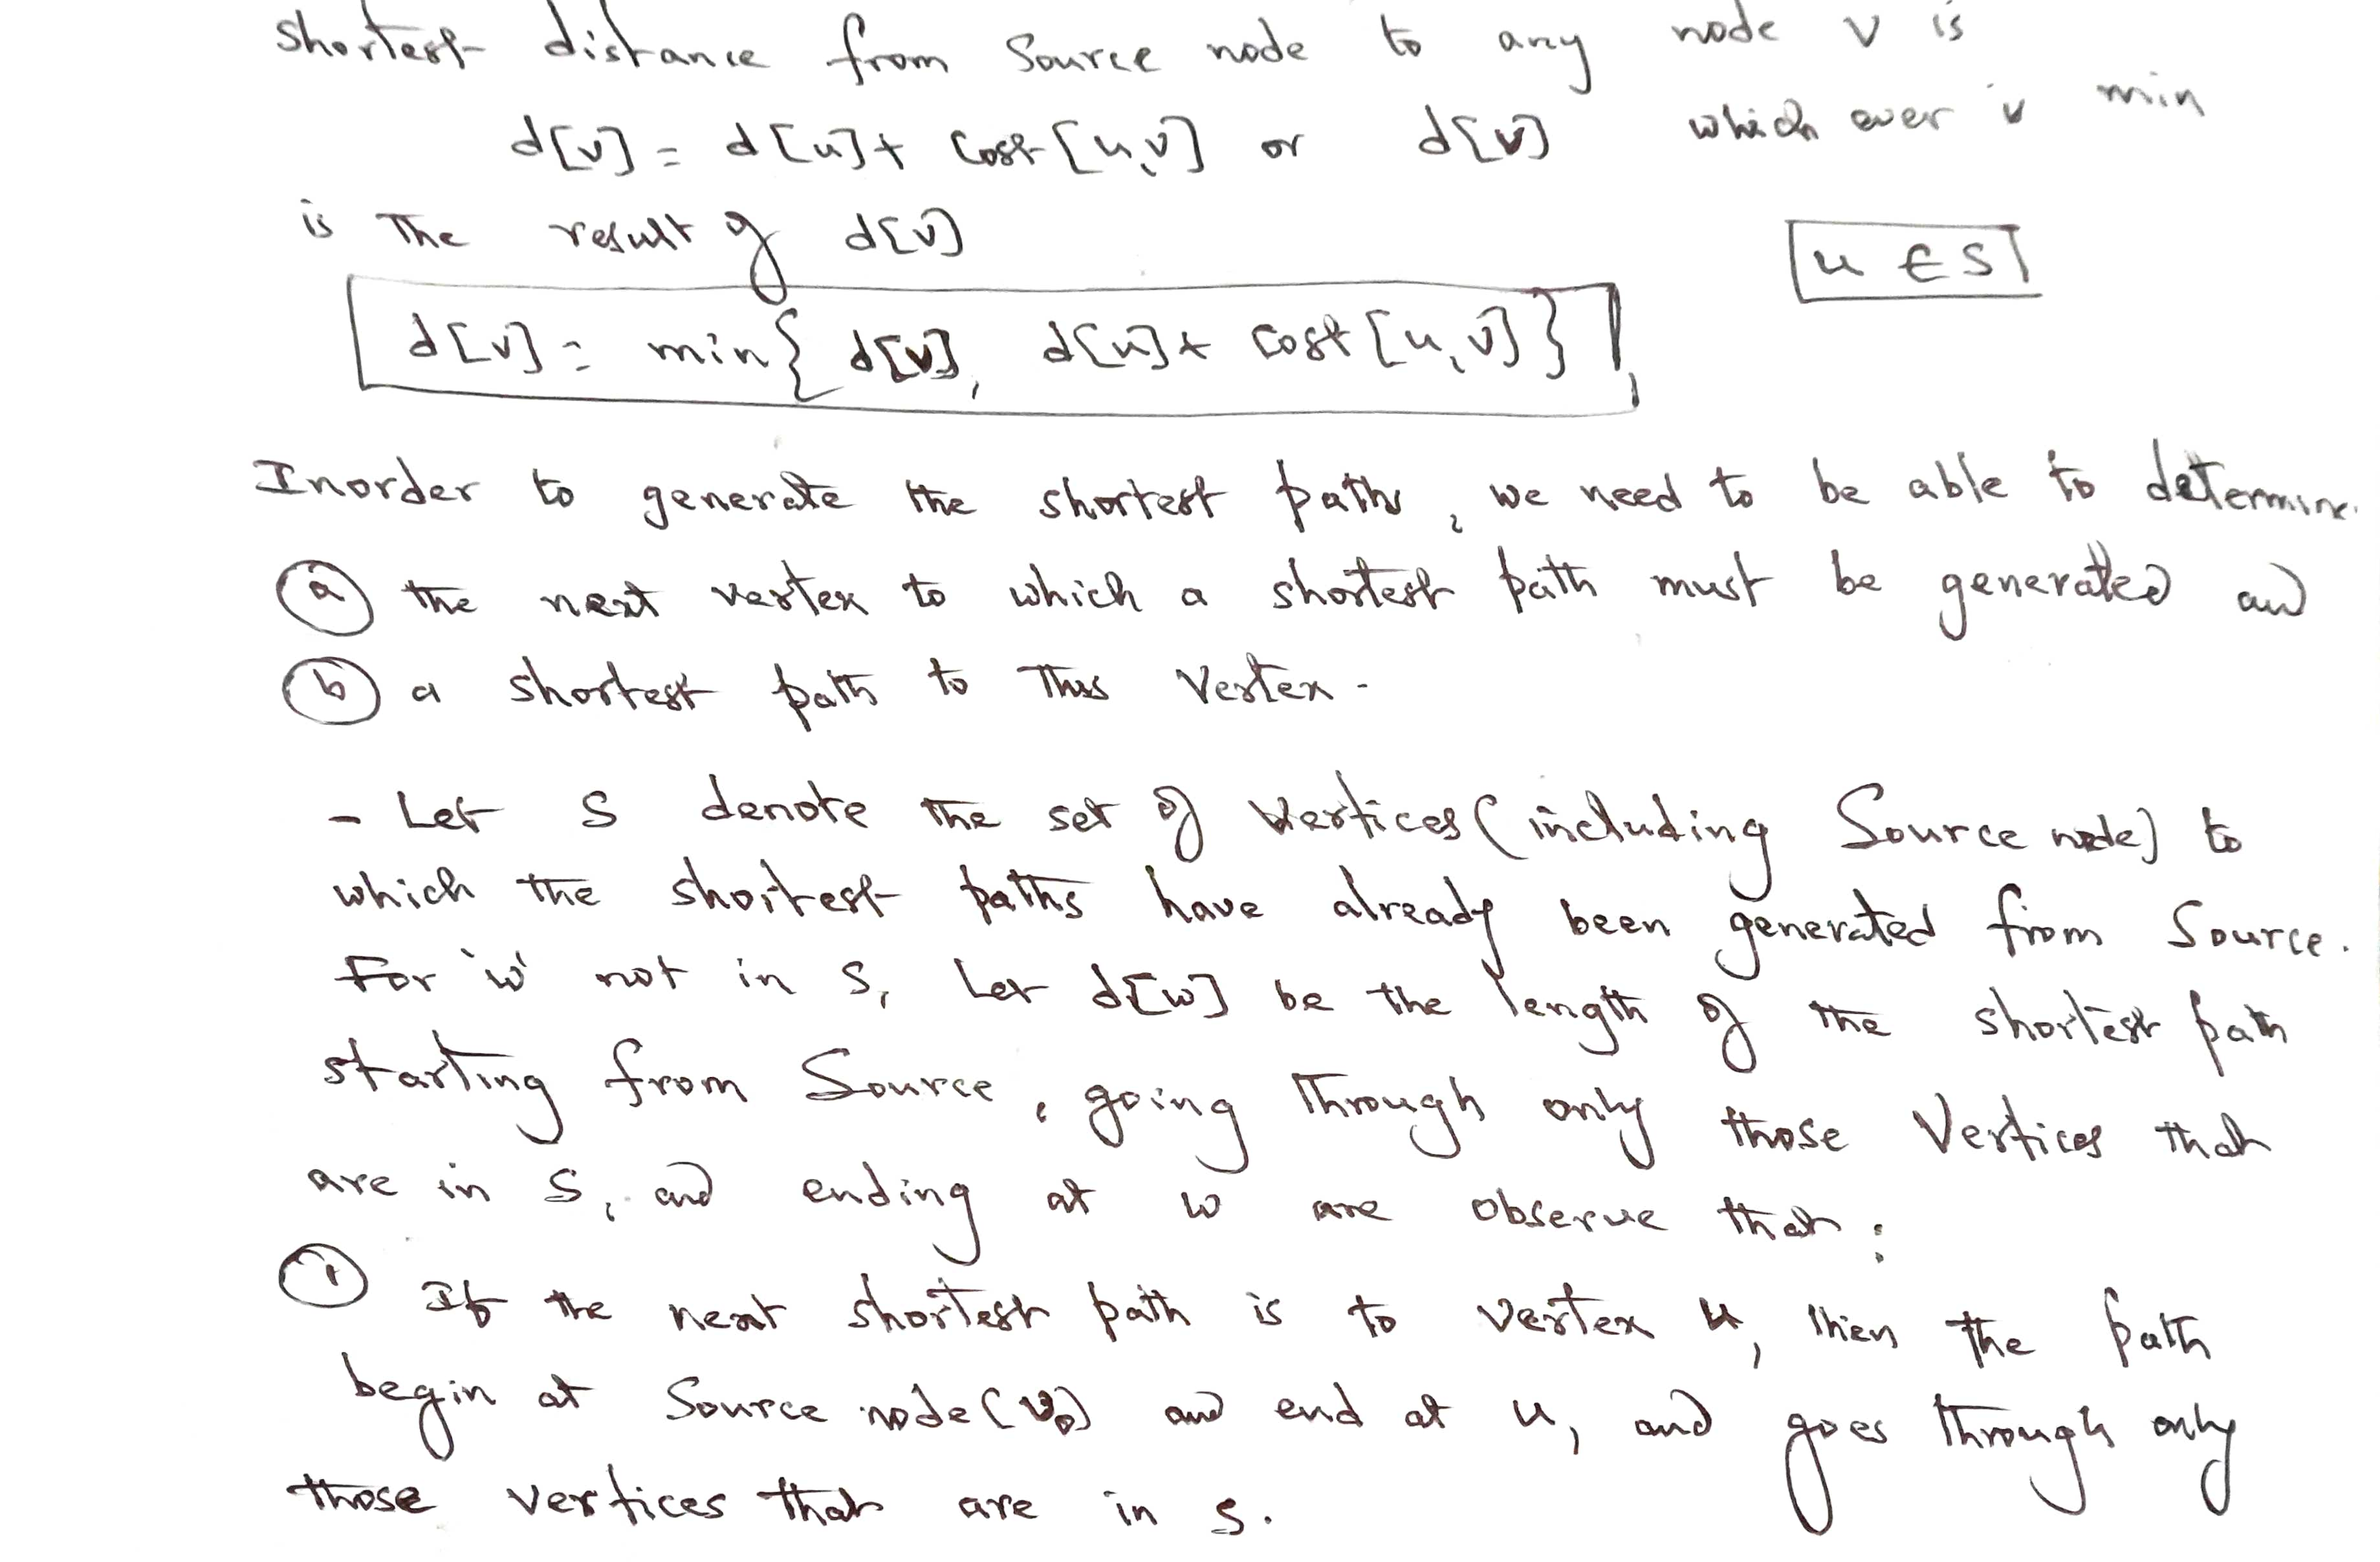
Single Source Shortest Path Problem

Slide 48
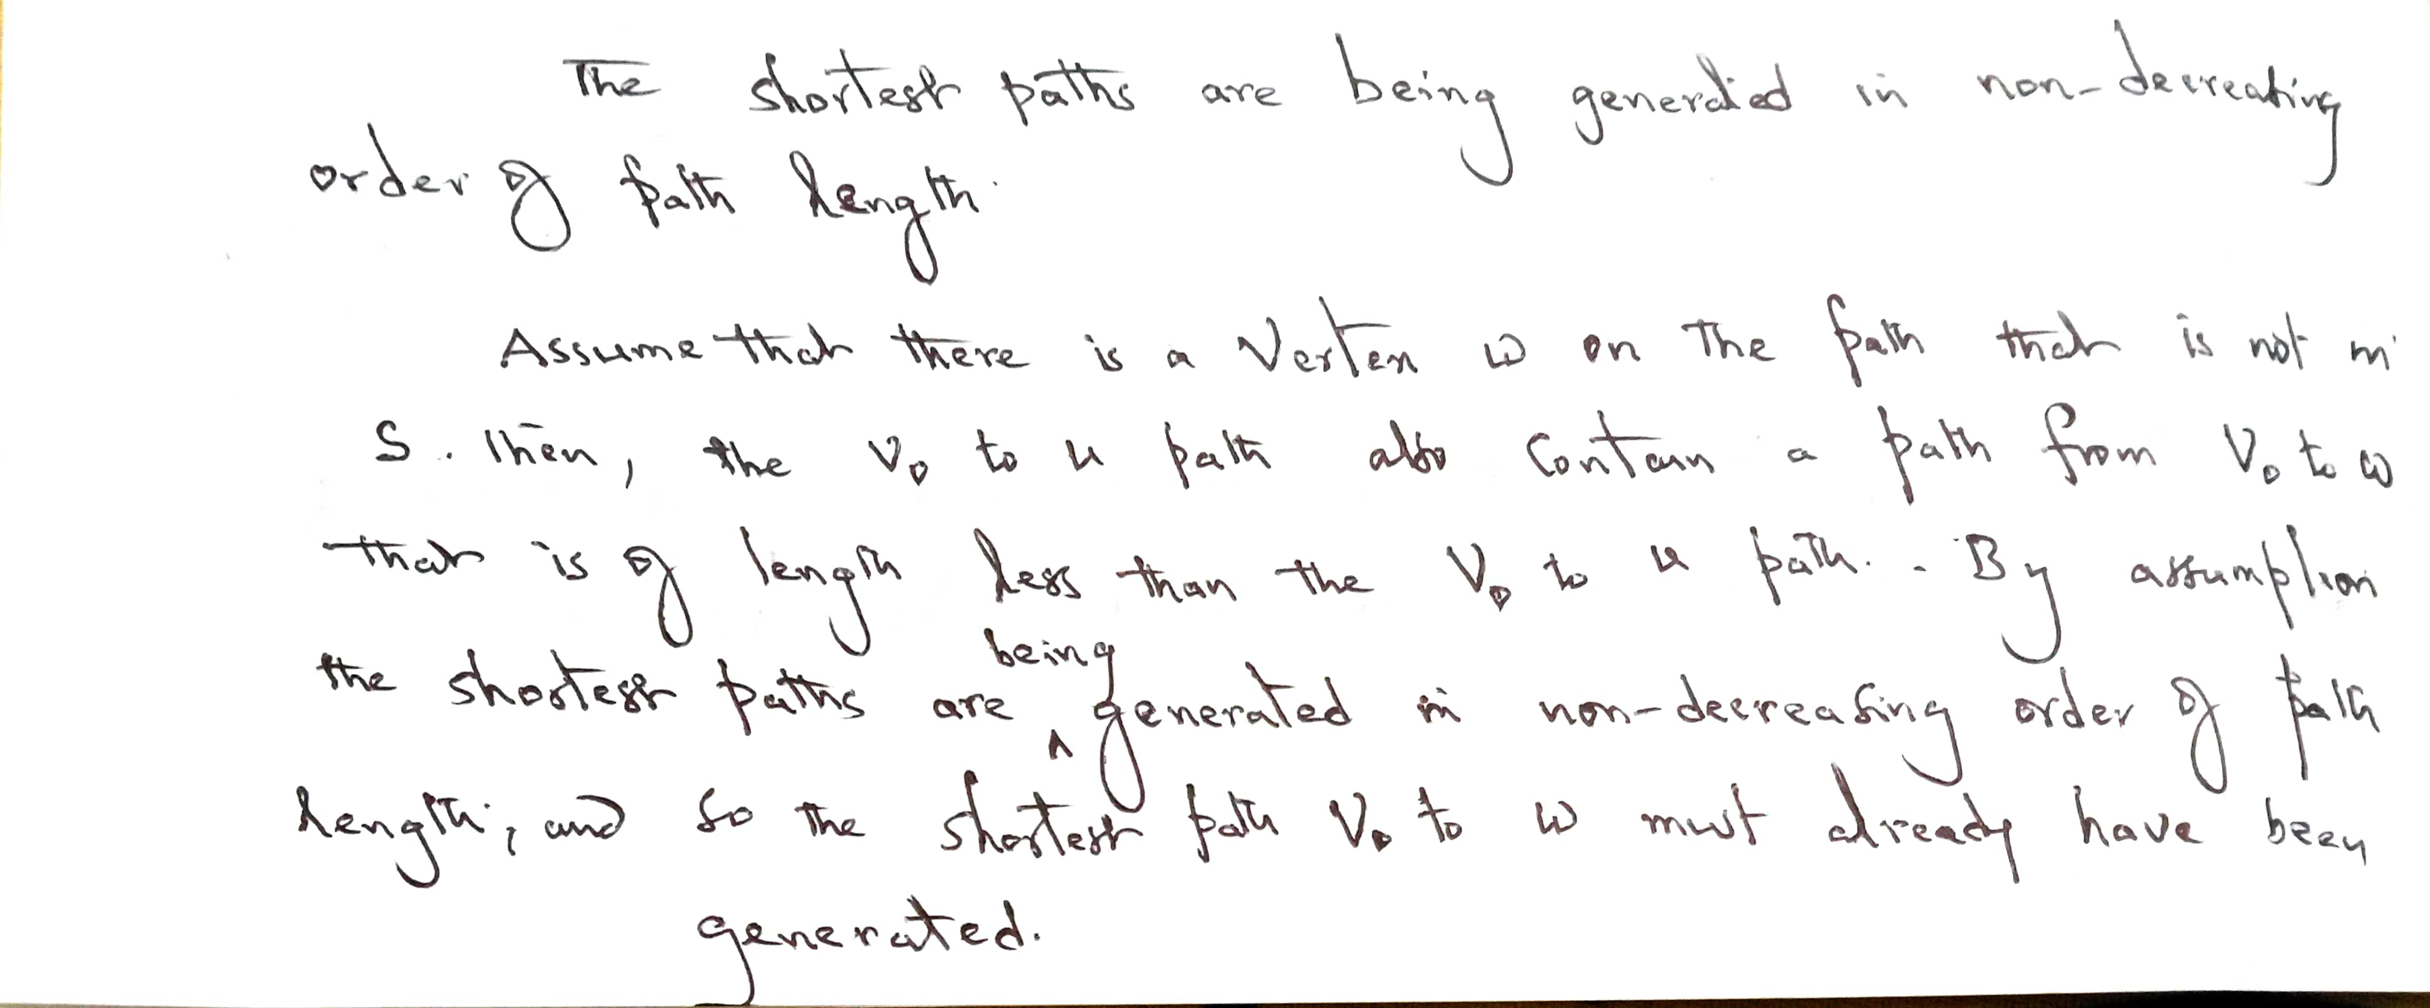
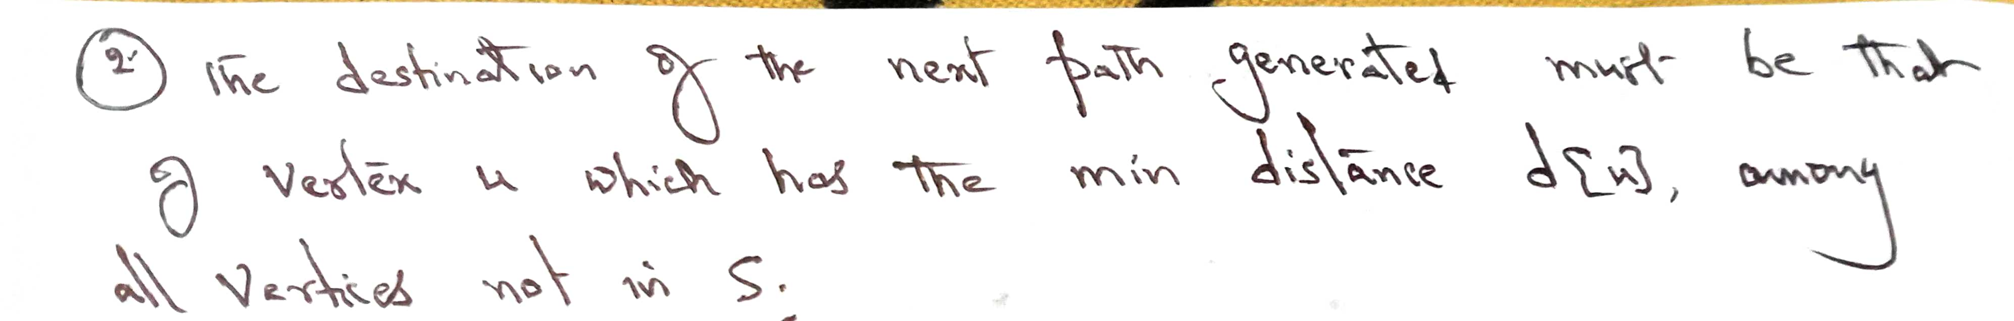
Single Source Shortest Path Problem

Slide 49
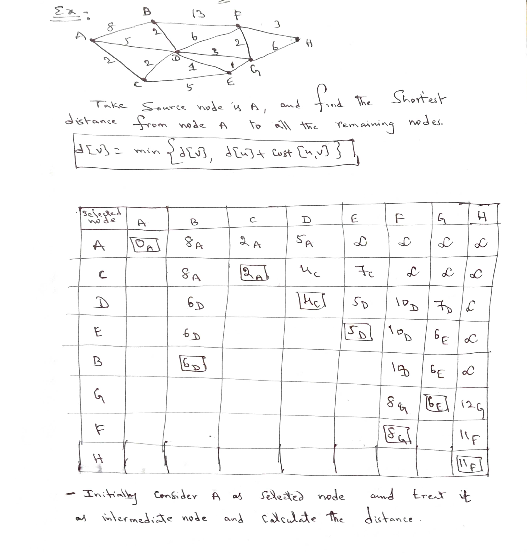
Single Source Shortest Path Problem

Slide 50


Slide 51


Slide 52


